Slide 1

Qualitative
Data collection Techniques
Training course in research methodology, research protocol development and scientific writing
Geneva 2023
Dr Khalifa Elmusharaf
MBBS, PgCert, PgDip, FRSPH, FFPH, MRSTMH, IPMA®C, PhD
Associate Professor in Public Health
Director of Public Health Programme
University of Birmingham Dubai, United Arab Emirates

Slide 2
Learning outcomes
By the end of the presentation, you should be able to:
Describe different types of data collection techniques.
Demonstrate dimensions, type of observations and how to prepare and conduct observation.
Understand the practical communication skills for interviews to ask good questions, probe and follow up questions.
Able to prepare for interview.
Understand the characteristics and uses of focus group discussions.

Slide 3
Overview of data collection techniques
Data collection techniques allow us to systematically collect information about our objects of study (people, objects, phenomena) and about the settings in which they occur.
In the collection of data, we have to be systematic. If data are collected haphazardly, it will be difficult to answer our research questions in a conclusive way.

Slide 4
data collection techniques
Observation
Interviews (face-to-face)
Focus group discussions

Slide 5
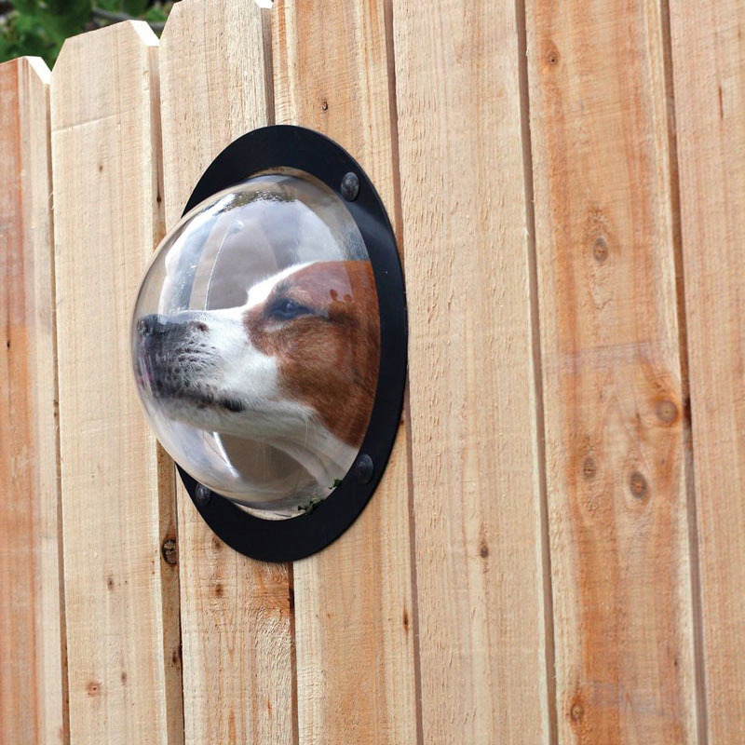
1. Observation

Slide 6
Observation
OBSERVATION is a technique that involves systematically selecting, watching and recording behaviour and characteristics of living beings, objects or phenomena.
Without training, our observations will heavily reflect our personal choices of what to focus on and what to remember.
You need to improve your sensitivity to details that you would normally ignore and at the same time to be able to focus on phenomena of true interest to your study.

Slide 7
Types of observation (1)
Observation of human behaviour
Participant observation: The observer takes part in the situation he or she observes.
Non-participant observation: The observer watches the situation, openly or concealed, but does not participate.

Slide 8
Types of observation (2)
Open
  (e.g., ‘shadowing’ a health worker with his/her permission during routine activities).
Concealed
  (e.g., ‘mystery clients’ trying to obtain antibiotics without medical prescription).
Observations of objects
  For example, the presence or absence of a latrine and its state of cleanliness.

Slide 9
Types of observation (3)
General observation may be used as the starting point in to be familiar with the setting and the new context.
More focus observation may be used to evaluate whether people really do what they say they do.
Access the unspoken knowledge of subject, that is, the subconscious knowledge that they would not be able to verbalise in an interview setting.
Compare a phenomena and its specific components in greater detail.

Slide 10
Preparing for Observation
Determine the purpose of the observation activity as related to the overall research objectives.
Determine the population(s) to be observed. Consider the accessibility of the population(s) and the venues in which you would like to observe them.
Select the site(s), time(s) of day, and date(s), and anticipate how long you will collect participant observation data on each occasion.
Decide how field staff will divide up or pair off to cover all sites most effectively.

Slide 11
Preparing for Observation cont’d
Consider how you will present yourself, both in terms of appearance and how you will explain your purpose to others if necessary.
Plan how and if you will take notes during the participant observation activity.
Remember to take your field notebook and a pen.

Slide 12
Dimensions of observation:
Space (physical places)
Actors (people involved)
Activities (the set of related acts people do)
Object (the physical things that are present)
Time (the sequencing that takes place over time)
Goal (the things people are trying to accomplish)
Feeling (the emotions felt and expressed)

Slide 13
After Observation
Schedule time soon after observation to expand your notes.
Type your notes into computer files using the standard format set for the study.

Slide 14

2. Inter-Views

Slide 15
Interview
An INTERVIEW is a data-collection (generation) technique that involves oral questioning of respondents.
Answers to the questions during the interview can be recorded by writing them down or by tape-recording the responses, or by a combination of both.

Slide 16
High degree of flexibility Interview:
This could be used for example when studying sensitive issues (teenage pregnancy and abortions), e.g.:
  How teenagers started sexual intercourse?
  The actions couples take in the event of unwanted pregnancies?
The investigator should have an additional list of topics ready when the respondent falls silent
  e.g., when asked about abortion methods used
  who made the decision and who paid

Slide 17
High degree of flexibility:
The sequence of topics should be determined by the flow of discussion.
It is often possible to come back to a topic discussed earlier in a later stage of the interview.
The unstructured or loosely structured method of asking questions can be used for interviewing individuals as well as groups of key informants (FGD).

Slide 18
Low degree of flexibility:
Less flexible methods of interviewing are useful when the researcher is relatively knowledgeable about expected answers or when the number of respondents being interviewed is relatively large.
Then interview guide may be used with a fixed list of questions in a standard sequence.

Slide 19
Practical communication skills for interviews
Good communication should lead to a shared understanding.
Be aware of nonverbal communication: body language and tone of voice.
Giving constructive feedback during the interview.
  Comment on positive things first
  Be constructive
  Be specific
  Do no give direct or blaming criticism

Slide 20
Ask good questions
Start with what, how, who, when, say “please give an example of”.
Question starting with “Why” make people feel uncomfortable.
Don’t ask a biased and leading or direct questions.
The type of question asked must be adapted to the changing level of trust between interviewer and informant during the interview.

Slide 21
PROBING
PROBING is a good questioning skill
Examples
Does the child have fever? (Closed question)
  Probes How high is the fever?
  Since when has he had the fever?
Have you given the child medicine?
  Probes What kinds of medicines have you given?
  How much? For how long?

Slide 22
Type of questions
Hypothetical question: e.g. “Suppose you had more money, how would you spend that?”
Provocative questions: e.g. “Some say that HIV is the punishment of God, what do you think about that?”
Ideal questions: e.g. “Please describe to me what a good delivery would be like”
Interpretative questions: e.g. “You said earlier that you go to healers for diarrhoea, how this related ideas about hot-cold?”
Experience questions: e.g. “Could you tell me about your experience of caring for patients with cancer?”

Slide 23
Type of questions
Feeling questions: e.g. “How did you feel when the first patient in your care died?”
Knowledge questions: e.g. “What services are available for this group of patients?”
Grand-tour questions: e.g. “Can you describe a typical day in the community? (to a community midwife)”
Mini-tour questions: e.g. “Can you describe what goes on when a women die giving birth?“
Example Questions e.g. “Can you give me an example of a difficult delivery?”

Slide 24
stages of questions during the interview
Stage of the question | Purpose
1. Opening questions | To identify the characteristics that the participants have in common. Participants should be given an opportunity to introduce themselves.
2. Introductory questions | To introduce the general topic of the discussion, and to stimulate the conversation and improve interaction in the group.
3. Transition questions | To move the participants into the focus of the discussion.
4. Key questions | Concern about the focus of the interview.
5. Ending questions | Give the participants an opportunity to make final statement.
7. Final questions | Ask the participants to add things they think have not been considered during the discussion.

Slide 25
Prepare for the interview
Recruit participants according to the recruitment strategy outlined in the work plan.
Set up recording equipment and the physical space where interviews will take place.
Become knowledgeable about the research topic, including anticipating and being prepared to answer any questions participants may have about it.
Be reliable. To get participants to take the interview seriously, you need to demonstrate your own commitment. Arrive on time, equipped with the recording equipment, interview guide, and notebooks. Be both mentally and psychologically prepared to conduct the interview. Keep all promises you make to participants.

Slide 26
Prepare for the interview Cont’d
Obtain informed consent from each participant before the interview.
Address all questions or topics listed in the interview guide.
Probe participants for elaboration of their responses, with the aim of learning all they can share about the research topic.
Ask follow-up questions (some of which may be scripted in the interview guide) in order to elicit participants’ complete knowledge and experience related to the research topic.

Slide 27
Document the interview
Record the interview using an audio (and sometimes video) recorder.
Take backup notes.
Observe and document participants’ behaviors and contextual aspects of the interview as part of your field notes.
Expand your notes as soon as possible after each interview, preferably within 24 hours, while your memory is still fresh.

Slide 28

3. FOCUS GROUP DISCUSSIONS (FGD)

Slide 29
Differences between interviews and FGD
 | Appropriate for | Strength of method
Interviews | Eliciting individual experiences, opinions, feelings Addressing sensitive topics | Elicits in-depth responses, with differences and contradictions. Gets at interpretive perspective, i.e., the connections and relationships a person sees between particular events, phenomena, and beliefs.
FGD | Identifying group norms Eliciting opinions about group norms Discovering variety within a population | Elicits information on a range of norms and opinions in a short time. Group dynamic stimulates conversation, reactions.

Slide 30
Characteristics and uses of FGD
Its purpose is to obtain in-depth information on concepts, perceptions and ideas of a group.
It aims to be more than a question-answer interaction.
The idea is that group members discuss the topic among themselves, with guidance from the facilitator.

Slide 31
FGD techniques can be used to:
1- Focus research and develop relevant research hypotheses by exploring in greater depth the problem to be investigated and its possible causes.
Example:
A district health officer noticed that there are an unusually large number of cases of malnutrition of children under 5 reported from one area in her district.
Because she had little idea of why there might be more malnutrition in that area, she decided to organise 3 FGD (one with leaders, one with mothers and one with health staff from the area).
She hoped to identify potential causes of the problem through the FGDs and then develop a more intensive study, if necessary.

Slide 32
2- Formulate appropriate questions for more structured, larger scale surveys.
Example:
In planning a study of the incidence of childhood diarrhoea and feeding practices, a FGD showed that in the community under study, children below the age of 1 year were not perceived as having ‘bouts of diarrhoea’ but merely ‘having loose stools’ that were associated with milestones such as sitting up, crawling, and teething.
In the questionnaire that was developed after the FGD the concept ‘diarrhoea’ was therefore carefully described, using the community’s notions and terms.

Slide 33
3- Help understand and solve unexpected problems in interventions.
Example:
In District X, the recent national (polio) immunisation days (NID) showed widely different coverages per village (50-90%) and in a number of villages a marked decrease in coverage was observed compared to last year.
Eight FGD were held with mothers, two in town, three in rural villages with a marked decrease in NID coverage and three in villages with a high coverage throughout.

Slide 34
3- Help understand and solve unexpected problems in interventions. Cont’d
Example (cont’d)
It appeared that overall, the concept NID had raised confusion. Most people believed that this mass campaign strengthened the children’s immunity against any (childhood) disease, including malaria and Respiratory Tract Infections.
In the villages with a low NID coverage there had been a high incidence of malaria in children immediately after the previous NID campaign and several children died. Mothers therefore believed that the NID campaign was useless.

Slide 35
4- Develop appropriate messages for health education programmes and later evaluate the messages for clarity.
Example:
A rural health clinic wanted to develop a health education programme focused on weaning problems most often encountered by mothers in the surrounding villages and what to do about them.
The FGD could be used for exploring relevant local concepts as well as for testing drafts when developing the messages.
The messages should be developed and tested in different socio-economic groups of mothers, as weaning practices may differ with income, means of subsistence and education of the mothers. Also, ethnic differences may have to be taken into account.

Slide 36
5- Explore controversial topics.
Example:
Sexual behaviour is a controversial topic in the sense that males and females judge sexual relations and sexuality often from very different perspectives. Sexual education has to take this difference into account.
Through FGDs, first with females, then with males, and then with a mixed group to confront both sexes with the different outcomes of the separate discussions (listed on flip charts) it becomes easier to bring these differences in the open. Especially for teenagers, who may have many stereotypes about the other sex or be reluctant to discuss the topic openly (particularly girls), such a ‘multi-stage’ approach is useful.

Slide 37
Strengths and limitations of FGD
A well chosen group, in terms of composition and number, FGDs can be a powerful research tool which provides valuable spontaneous information in a short period of time and at relatively low cost.
FGD should not be used for quantitative purposes, such as the testing of hypotheses or the generalisation of findings for larger areas, which would require more elaborate surveys.
Depending on the topic, it may be risky to use FGDs as a single tool. In group discussions, people tend to centre their opinions on the most common ones, on ‘social norms’.

Slide 38
Strengths and limitations of FGD cont’d
In reality, opinions and behaviour may be more diverse. Therefore, it is advisable to combine FGDs with at least some key informant and in-depth interviews.
In case of very sensitive topics, such as sexual behaviour or coping with HIV/AIDS, FGDs may also have their limitations, as group members may hesitate to air their feelings and experiences freely.
One possible remedy is the selection of participants who do not know each other (e.g., selection of children from different schools in FGDs about adolescent sexual behaviour), while assuring absolute confidentiality.

Slide 39
HOW TO CONDUCT A FGD

Slide 40
1. Determine the purpose
A FGD can be regarded as a mini-study.
It therefore requires one or two clear objectives.
These objectives will guide the research team in the formulation of discussion questions.

Slide 41
2. Situation analysis
Any FGD requires good knowledge of local conditions. There are always differences between community members, for example in education, political power, gender, economic status and ethnic group. These differences will be reflected in their perceptions of the problems they suffer from and possible solutions. A researcher must be aware of these differences.
The first task of the researchers will be to explore the area and identify possible target groups.
Interviews with some key informants and a rudimentary situation analysis are then indispensable.
The situation analysis should preferably be carried out in a participatory way, with representatives of the study population on which the FGD focuses.

Slide 42
3. Recruitment of participants
Participants should be roughly of the same socio-economic group or have a similar background in relation to the issue under investigation.
The age and sexual composition of the group should facilitate free discussion.
If you are an outsider, you may have to rely on your key informants for the first selection of participants in FGDs.
Your key informants to whom you have explained thoroughly the purpose and the process of the FGD might each suggest some individuals who could be invited to a focus group discussion.

Slide 43
3. Recruitment of participants cont’d
The key informants may select persons similar to themselves so that you do not get an adequate variety of views in your discussion group.
So, in your explanations be sure to emphasise that you want a group of people that can express a range of views, to be able to have a proper discussion.
Participants in a first FGD may assist to find relevant participants for other groups.
Another way is to select individuals in a systematic way, to try and ensure a range of views. You might, ask every third or fourth person you find. This method might be more suitable in urban areas.

Slide 44
4. Physical arrangements:
Communication and interaction during the FGD should be encouraged in every way possible.
Arrange the chairs in a circle. Make sure that there will be no disturbances, sufficient quietness, adequate lighting, etc.
Try to hold the FGD in a neutral setting which encourages participants to freely express their views.
A health centre, for example, is not a good place to discuss traditional medical beliefs or preferences for other types of treatment.

Slide 45
5. Preparation of a discussion guide:
There should be a written list of topics to be covered.
It can be formulated as a series of open-ended questions.
Guides for different groups gathered to discuss the same subject may vary slightly, depending on their knowledge or attitudes and how the subject should first be explored with them.

Slide 46
6. Functions of the facilitator
Introduce the session.
Encourage discussion and involvement.
Deal correctly with sensitive issues.
Observe non-verbal communication.
Avoid being placed in the role of expert.
Control the rhythm of the meeting.
Take time at the end of the meeting to summarise, check for agreement and thank the participants.
Summarise the main issues brought up.
Listen for additional comments and spontaneous discussions after the meeting has been closed.

Slide 47
7. Functions of the recorder
The recorder should keep a record of the content of the discussion as well as emotional reactions and important aspects of group interaction. Assessment of the emotional tone of the meeting and the group process will enable you to judge the validity of the information collected during the FGD.
Items to be recorded include:
  Date, time, place
  Names and characteristics of participants
  General description of the group dynamics (level of participation, presence of a dominant participant, level of interest)
  Opinions of participants, recorded as much as possible in their own words
  Emotional aspects
  Vocabulary used – (to use it in developing questionnaires or health education materials)
  Spontaneous relevant discussions during breaks or after the meeting has been closed

Slide 48
8. Duration of sessions
A focus group session typically lasts up to an hour and a half.
Generally, the first session with a particular type of group is longer than the following ones because all of the information is new.
Thereafter, if it becomes clear that all the groups have a similar opinion on particular topics, the facilitator may be able to move the discussion along more quickly to other topics which still elicit new points of view.

Slide 49
9. Number of sessions
It depends upon project needs, resources, and whether new information is still coming from the sessions (Saturation).
One should plan to conduct at least two FGDs for each sub-group (for example, two for males and two for females).
Otherwise, you have no way of assessing whether the information you get from the first FGD is representative for that group.

Slide 50


Reading materials
https://www.fhi360.org/sites/default/files/media/documents/Qualitative%20Research%20Methods%20-%20A%20Data%20Collector's%20Field%20Guide.pdf

