Slide 1
Reaching adolescents through teachers & community-based educators
November 2015
Dr V Chandra-Mouli
(chandramouliv@who.int)
Training Course in Sexual and Reproductive Health Research
Geneva 2015

Slide 2
Sexuality education - Definition
Sexuality Education is defined as an age-appropriate, culturally relevant approach to teaching about sex and relationships by providing scientifically accurate, realistic, non-judgmental information.
Source: UNESCO, UNAIDS, UNFPA, UNICEF and WHO. International technical guidance on sexuality education. Volume 1. The rationale for sexuality education. An evidence-informed approach for schools, teachers and health educators. UNESCO. Paris. 2009.
Notes:
This definition of sexuality education is from the International Technical Guidance on Sexuality Education.

Slide 3
Key statement 1. Children & adolescents need & have a right to sexuality education.

Slide 4
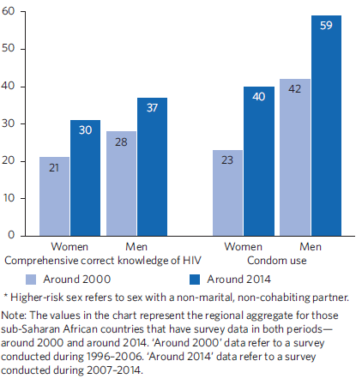
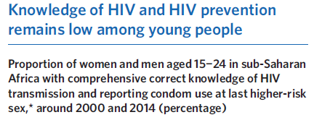
HIV/AIDS
United Nations. Millennium Development Goals Report: 2015. UN, New York, 2015.
Notes:
Many adolescents – girls more than boys – have important knowledge gaps and misconceptions.

Slide 5
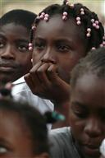
Menstruation
How knowledgeable are adolescent girls in low- and middle-income countries about menstruation & how prepared are they for reaching menarche?
Recognition that is a physiological process ranges from 6.0% to 86.3%
Poor awareness prior to reaching menarche ranges from 32.5% to 81.6%
Initial perception upon reaching menarche is that it is life-threatening, many believe it is unnatural
Poor awareness of the origins of menstrual blood as high as 97.5%
Negative feelings including fear, disgust, anxiety and confusion
V Chandra-Mouli, S V Patel, M Sommer. Systematic Review: Knowledge and Understanding of Menarche, Menstrual Hygiene and Menstrual Health among Adolescent Girls in Low- and Middle-income Countries. Submitted for review.
Notes:
Many children and adolescents – boys and girls – are unprepared for puberty.

Slide 6
Key statement 2. Sexuality education is not just about teaching about sex, reproduction & avoiding sexual & reproductive health problems.

Slide 7
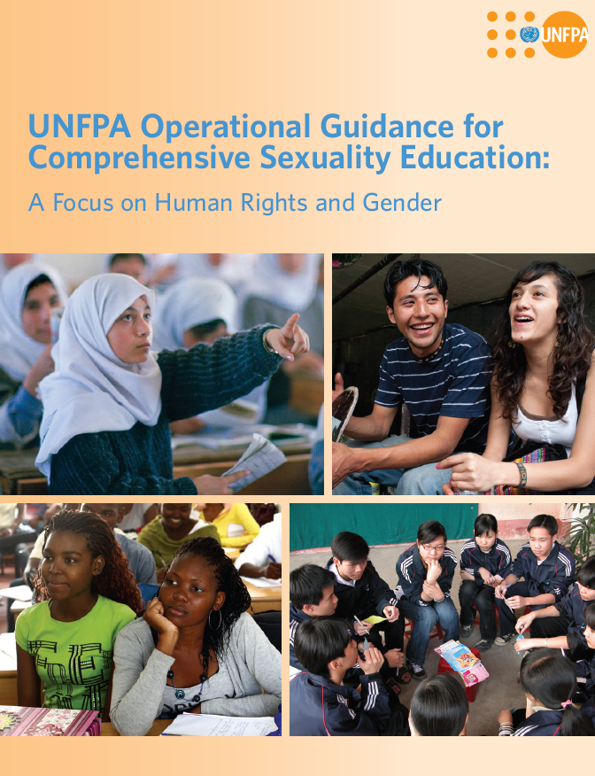
It aims to:
improve knowledge & understanding
promote self awareness & equitable social norms
build social skills to make and follow through on choices
Notes:
Sexuality education is not just about teaching children and adolescents about sex, reproduction and avoiding sexually transmitted infections and unwanted pregnancies. It is more than that.
It aims to improve knowledge and understanding, and to correct misconceptions by providing age-appropriate, scientifically accurate, and culturally relevant information.
Two examples of questions that adolescents ask are:
Why are my periods painful ?
Will I lose my manhood if I do not have sex now ?
It aims to promote self-awareness and norms that are equitable and respectful of others, by providing opportunities to discuss and reflect on thoughts and feelings, attitudes and values.
Two examples of issues to stimulate such discussion and reflection are:
How would you feel if someone teased you about your appearance or body odour ?
Is it true that only a boy can say he finds a girl attractive and would like to go out with her ?
It aims to build social skills needed to make responsible choices and to carry them out, by providing structured opportunities to practice those skills.
Two examples of issues to role play scenarios are:
If someone looks at you or touches you in a way that you do not want, how would you tell them to stop ?
How would you tell a friend that you do not want to join her for a party without breaking your friendship ?
To sum up, sexuality education is intended to prepare children and adolescents for the choices they will need to make and the challenges they are likely to face in their sexual and reproductive lives.

Slide 8
Key statement 3. Sexuality education does not harm children & adolescents; it can do them a lot of good.

Slide 9
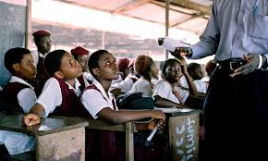
Sexuality education:
Does not lead to early or increased sexual activity
Well designed & well conducted sexuality education can:
bring about positive changes in sexual behaviour (demonstrated in more studies),
reduce negative health outcomes (demonstrated in less studies)
Sexuality education that addresses gender & power:
are more likely to be effective in reducing unwanted health outcomes
N Haberland, D Rogow. Sexuality Education: Emerging Trends in Evidence and Practice. Journal of Adolescent Health, 2015.
N Haberland. The case for addressing gender & power in sexuality and HIV education: A comprehensive review of evaluation studies. International perspectives in sexual and reproductive health, 2015.

Slide 10
Key statement 4. We are failing to reach children and adolescents with sexuality education.

Slide 11
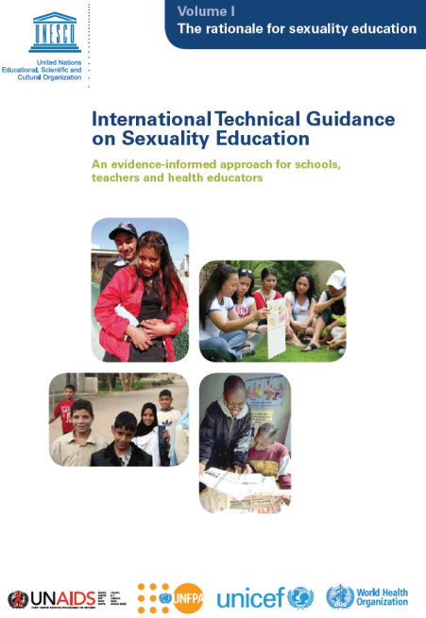
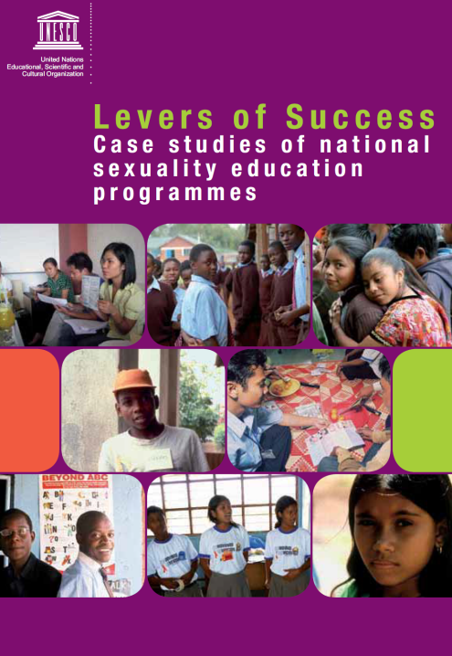
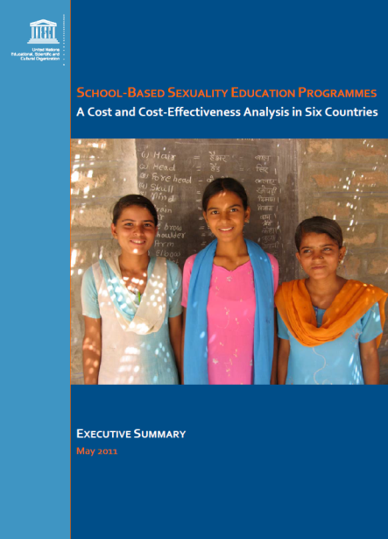
Sexuality education – generating evidence
Evidence generated
Effectiveness of interventions
Effective means of delivering interventions at scale in a sustained manner
Cost of delivering them
Notes:
We have solid evidence.

Slide 12
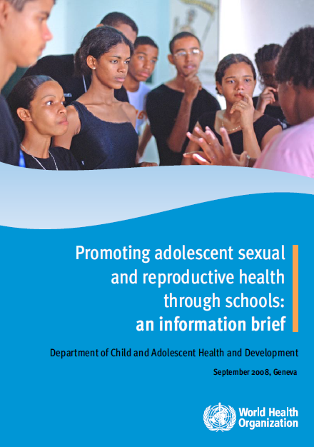
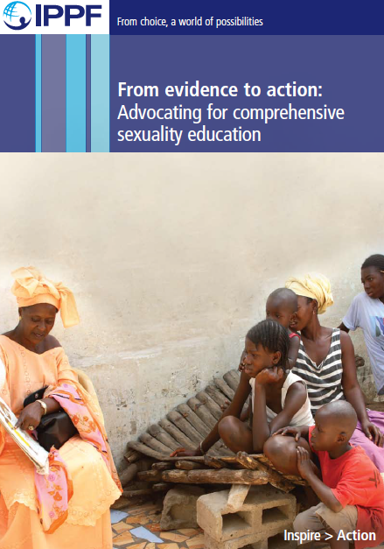
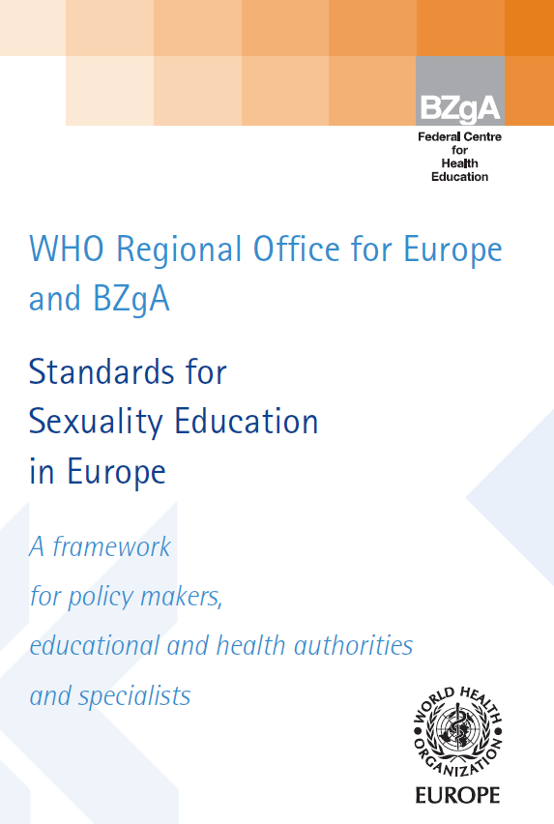
Sexuality education – developing policy/programme support tools
Advocacy & programme support tools
developed
Notes:
We have a battery of tools.

Slide 13
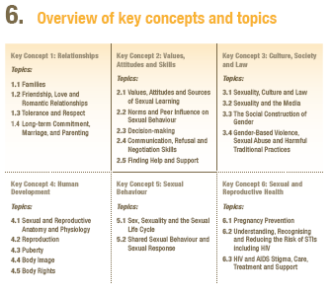
Sexuality education – Content (from UNESCO, International technical guidance on sexuality education, 2009)
Relationships
Values, Attitudes and Skills
Culture, Society and Human Rights
Human Development
Sexual Behaviour
Sexual and Reproductive Health
Notes:
There are six items in the list of contents.
Each item is linked to specific learning objectives, grouped according to the four age levels:
1. ages 5 to 8 (Level I)
2. ages 9 to 12 (Level II)
3. ages 12 to 15 (Level III)
4. ages 15 to 18+ (Level IV)
The learning objectives are the intended outcomes of working on particular topics. They are defined at the level when they should be first introduced, but they need to be reinforced across different age levels.
When a programme begins with older students, it may be necessary to cover topics and learning objectives from earlier age levels.
Based on needs and country/region-specific characteristics, such as social and cultural norms and epidemiological context, the contents of the learning objectives could be adjusted to be included within earlier or later age levels.
However, most experts believe that children and young people want and need sexuality and sexual health information as early and comprehensively as possible.

Slide 14
Sexuality education – Process (from UNESCO, International technical guidance on sexuality education, 2009)
Notes:
These are the characteristics of sexuality education curricula which have been evaluated and have been found to be effective in terms of increasing knowledge, clarifying values and attitudes, increasing skills and impacting upon behaviour.

Slide 15
Sexuality education - Good practice (from UNESCO, International technical guidance on sexuality education, 2009)
Implement programmes that include at least 12 or more sessions
Include sequential sessions over several years
Select capable and motivated educators to implement the curriculum
Provide quality training to educators
Provide on-going management, supervision and oversight
Notes:
In addition, to the points listed in the previous slide, the International Technical Guidance document lists a short list of exemplary practices which are based on years of experience and research.

Slide 16
Sexuality education – taking evidence to action
“Most adolescents & youth do not yet have access to comprehensive sexuality education (CSE), despite repeated intergovernmental agreements to provide it, support from the UN system, & considerable project-level experience in a wide range of countries and research showing its effectiveness."
Report of the Secretary General, United Nations on
'Assessment of the status of implementation of Programme of Action of the ICPD', Commission on Population and Development, April 2014.
They reach pupils late
They do not reach marginalized adolescents
Their messages do not relate to the realities of many adolescents' lives
They are poorly delivered
They are not linked to health services
N Haberland, D Rogow. Sexuality Education: Emerging Trends in Evidence and Practice. Journal of Adolescent Health, 2015.
Notes:
But we are not able to translate it into action.

Slide 17
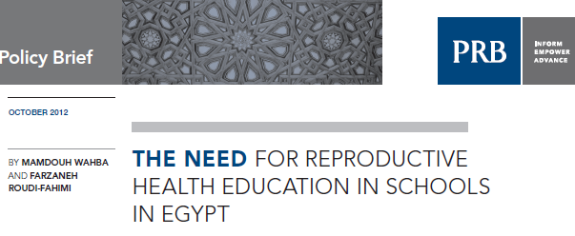
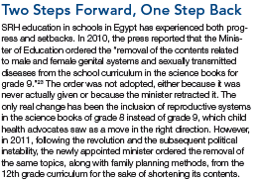
Notes:
In many countries there is discomfort and resistance to sexuality education.

Slide 18
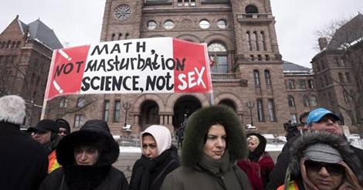
Source: Nowtoronto.com
Notes:
As this photograph from Toronto shows, this is not limited to some countries.

Slide 19
Key statement 5. A small number of countries are pushing beyond 'boutique' projects to implement large scale & sustained sexuality education programmes in schools.

Slide 20
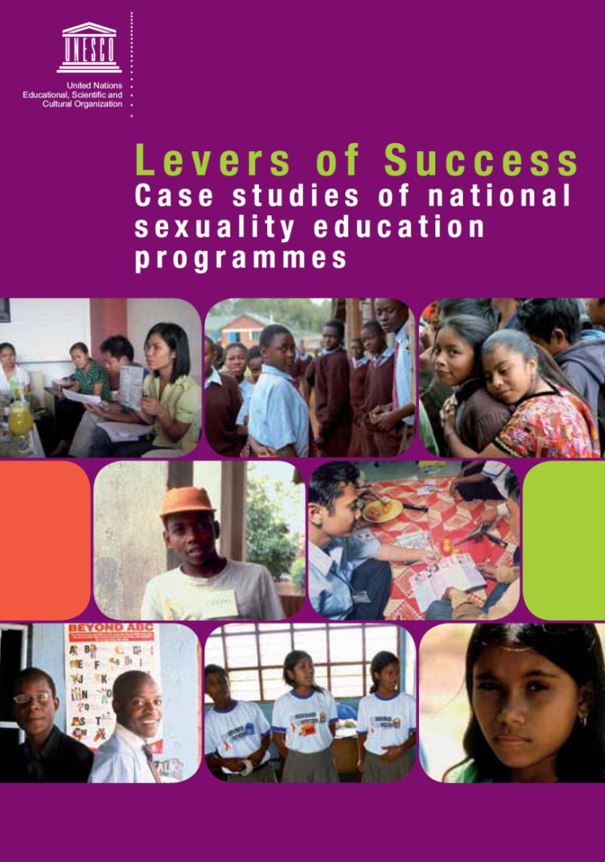
Positive deviant countries - Nigeria
2002 - After an extensive consultative process, a national policy was made to scale up school-based education using the Family Life & HIV Education (FLHE) curriculum.
Trained 'carrier-teachers' deliver FLHE to junior & senior secondary schools
2012 – FLHE has now been introduced in more than 30 (out of 36) states
Well-done studies in some states have shown improvements in knowledge, understanding & reported behaviours.
S Huaynoca, V Chandra-Mouli, N Yaqub Jr, D M Denno. Scaling up comprehensive sexuality education in Nigeria: from national policy to nationwide application. Sex Education, 2013. doi: 10.1080/14681811.2013.856292.
Notes:
Some countries and making progress. Nigeria is an example.

Slide 21
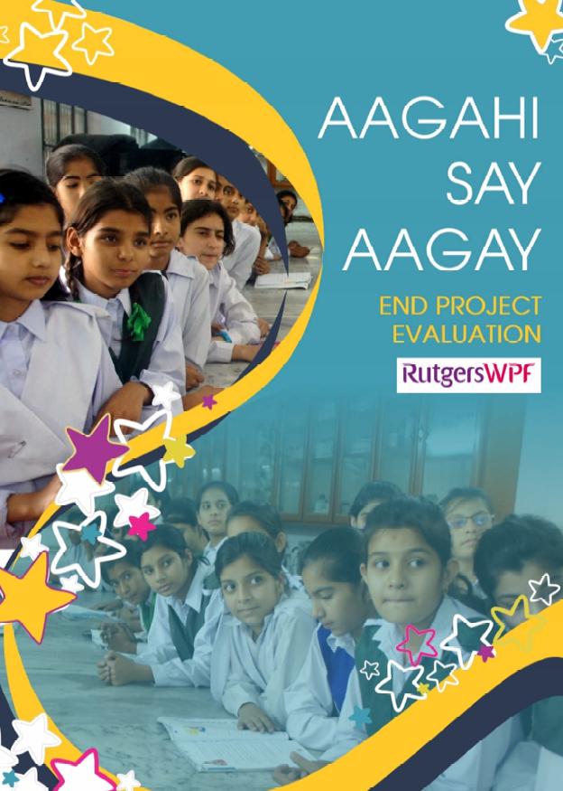
Positive deviant countries - Pakistan
Perceived the need for life skills based education
Motivated to implement it
Had a good understanding of the political, social and cultural environments
Able to advocate effectively
Able to identify and generate financial resources
Had an indepth understanding of the education system's capacities and limitations
Able to train and support the education system staff
J Svanemyr, Q Baig, V Chandra-Mouli. Scaling up life skilled based sexuality education in Pakistan: A case study. Sex Education, 2015. doi: 10.1080/14681811.2014.1000454.
Notes:
Pakistan is another example.
This slide shows why a group of NGOs were able to move ahead with sexuality education in a conservative country.

Slide 22
Key statement 6. While there is continued (and growing) resistance, there are also global and regional initiatives to move the agenda forward.

Slide 23
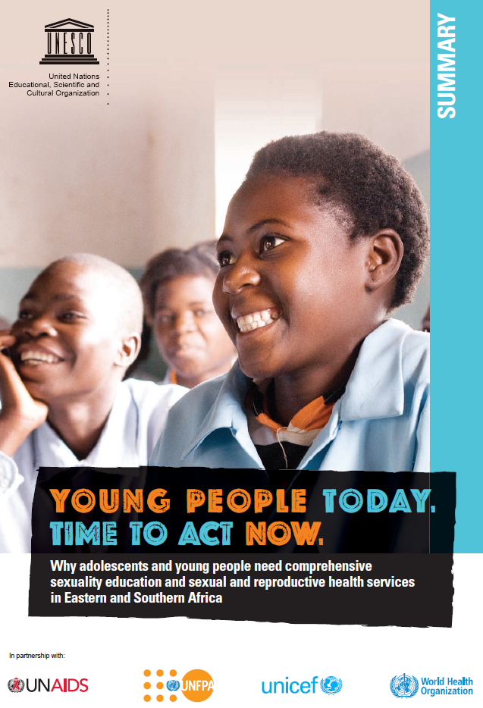
Eastern & Southern African Ministerial Commitment on comprehensive sexuality education and sexual and reproductive health services for adolescents and young people
"We, the Ministers of Education and Health from 20 countries in Eastern and Southern Africa , gathered in Cape Town, South Africa on 7 December 2013, working towards a vision of young Africans who are global citizens of the future…
…we will lead by bold actions to ensure quality comprehensive sexuality education and youth-friendly sexual and reproductive health services in the ESA region".
Notes:
Enrolment

