Slide 1

September 2025
Training course in research methodology, research protocol development and scientific writing 2025
Course overview
Geneva Foundation for Medical Education & Research in partnership with Oxford Maternal & Perinatal Health Institute (OMPHI) and the Department of Sexual and Reproductive Health & Research, World Health Organization (WHO)
Dr Raqibat Idris, MBBS, DO, MPH

Slide 2
Collaborating partners
Geneva Foundation for Medical Education and Research (GFMER),
Oxford Maternal & Perinatal Health Institute (OMPHI) and
The Department of Sexual and Reproductive Health & Research, World Health Organization (WHO)

Slide 3
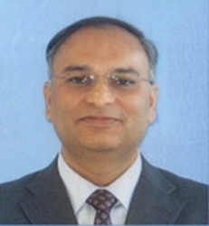
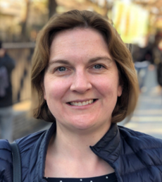
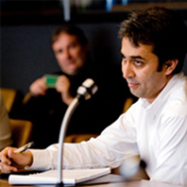
Course coordinators
Dr Moazzam Ali
Department of Sexual and Reproductive Health & Research, World Health Organization
Prof Jane Hirst
Program Director, Women's Health, Clinical Chair in Global Women's Health, Imperial College London and Visiting Professor, Nuffield Department of Women's & Reproductive Health, University of Oxford UK
Dr Karim Abawi
Geneva Foundation for Medical Education and Research

Slide 4
Course objectives
To provide knowledge and skills in research methodology, research protocol development and scientific writing to health professionals in sexual and reproductive health field.
The course will enhance participants’ understanding of research methodology and how to develop research protocols and improve their scientific writing.

Slide 5
Thematic areas
Literature search and referral to biomedical documents: Conducting a literature search and referencing
Epidemiologic studies: Provides basic knowledge on different epidemiological studies used to conduct research projects
Scientific writing: Provides instruction on scientific writing, such as articles or reports, based on academic criteria
Research protocol development: Provides practical instructions on how to develop a research protocol according to the WHO recommended format

Slide 6
Course topics & dates
03 September 2025 - 28 October 2025 (8 modules)
03 Sep.
I. Introduction: Research topic selection, research question and research problem statement
10 Sep.
II. Types of research, Effective literature search and citing biomedical documents and sources
17 Sep.
III. Epidemiologic studies
24 Sep.
IV. Systematic review and Implementation research
01 Oct.
V. Sampling (sample size and sampling technique) and quantitative data collection
08 Oct.
VI. Qualitative study design
16 Oct.
VII. Research ethics and Critical appraisal of research publication
23 Oct.
VIII. Research protocol development and scientific writing
Research protocol development
Research protocol submission deadline: 09 December 2025

Slide 7
What each course module will contain
Each module contains:
Slide sets
Reference documents/ resources
Links to useful videos
Assignments
Multiple-choice questions (end of course)
Written assignments (weekly)
Research protocol development

Slide 8

Teaching-learning methods
What the course organizers will do to support the participants:
A GFMER mentor will be assigned to you at the start of the course, to serve as your coach and guide.
Your mentor will review your paperwork assignments & research protocols and provide you with feedback promptly.
You can reach out to your mentor by email whenever required or if needed by phone.
You can always contact the GFMER secretariat with questions or concerns.

Slide 9
Teaching-learning methods cont’d
What is required of you (the course participants):
To connect with your mentors at the start of the course & to reach out to them when needed
To develop and submit a research protocol under the guidance of your mentor
To complete & submit the end of course evaluation
For each module:
Study the slide sets
Read all accompanying documents
Complete the short assignments and the end of course MCQs
Attend the live webinars and/ or watch the recordings
Participate in the course Google Groups forum
Participate in the end-of-course ZOOM meeting
Each module will take about 6 hours of work/week (total 60 hours of work including research protocol development)

Slide 10
Teaching-learning methods cont’d
Google Groups:
You will receive an invitation to join the group.
You will need a Google account to join and post in the group.
You can create a Google account without changing your email address. Alternatively, you can create a new Gmail address. Learn how at: https://accounts.google.com/SignUpWithoutGmail
Once you become a group member, you can create a new topic for discussion or response to any topic through email or direct access to the group website.
Google has clear online instructions on how to access and participate in the group at: https://support.google.com/groups/answer/1067205#join

Slide 11
Online meeting schedules
Activity | Description | Date and time
Webinar 1 | To respond to questions from participants and coaches on Weeks 1 to 5 topics Panelist: Dr Moazzam Ali (WHO) | Tuesday 30 September 2025 Time: 3 PM CET (Geneva time)
Webinar 2 | To respond to questions from participants and coaches on qualitative study design Panelist: Dr Khalifa Elmusharaf (University of Birmingham) | Thursday 16 October 2025 Time: 11 AM CET (Geneva time)
Webinar 3 | Online teaching session on: Critical appraisal of research publication Scientific writing Panelist: Prof Jane Hirst (University of Oxford) | Thursday 23 October 2025 Time: 3 PM CET (Geneva time)
End of course meeting | For participants, coaches, course organizers, course resource persons to reflect on the course | To be decided

Slide 12

Certificates
In order to validate the course and obtain the certificate, the participants are required to develop a research protocol relevant to their professional practice and under the guidance of their personal coach.

Slide 13
Organizing team: Names and designations
GFMER core team
Prof Aldo Campana, GFMER Director
Dr Raqibat Idris, GFMER Course Manager raqibat.idris@gfmer.org
Ms. Fionna Poon, GFMER Course Administrator fionna.poon@gfmer.org
Dr Aseel Mugahed
Dr Fariza Rahman
Course coordinators
Dr Moazzam Ali, Department of Sexual and Reproductive Health and Research, WHO
Prof Jane Hirst, Nuffield Department of Women’s & Reproductive Health, University of Oxford (UK)
Dr Karim Abawi, Executive Committee member, GFMER

Slide 14
Welcome to the course!

