Slide 1


Introduction to the WHO Library
Dr Raqibat Idris (MBBS, DO, MPH)
Training course in research methodology, research protocol development and scientific writing
Geneva, 2025
Notes:
Welcome to Module 2: Types of research, effective literature search and citing biomedical documents and sources where you will learn about the different types of research designs, conducting a literature search and referencing. This presentation is about the WHO Library which is a very useful online resource for finding public health information.

Slide 2
Objective
To introduce readers to the WHO Library resources and how to search for information in the Library
Notes:
In the presentation, you will learn about the resources available at the WHO Library and how to search for information in the Library.

Slide 3
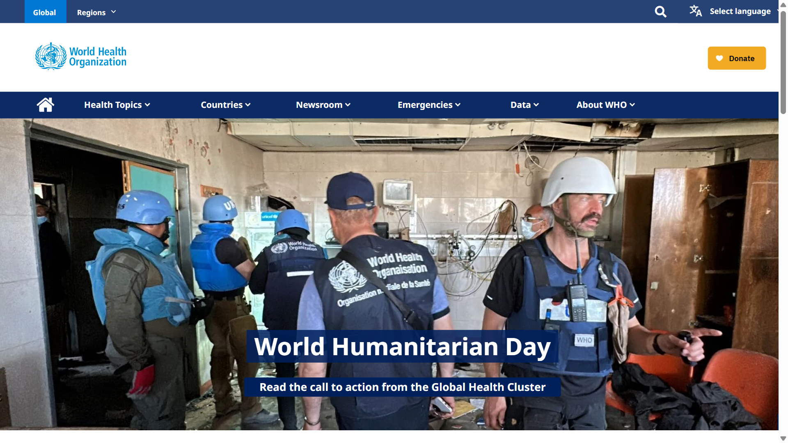
WHO website
https://www.who.int/
Notes:
Although this presentation is about the WHO Library, participants should be familiar with the WHO Website available at: https://www.who.int/
The website contains a wealth of resources outside the Library resources that can be useful to health professionals for research and in their practices.
The website can be browsed in major languages as shown in the slide.
You can click on the ‘Global’ tab to browse global contents or ‘Regions’ tab to access the regional websites.

Slide 4
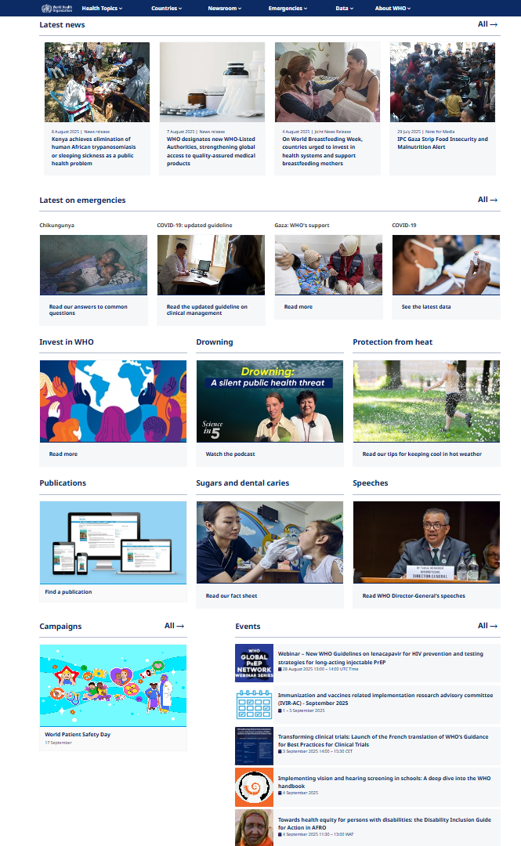
WHO website
https://www.who.int/
Notes:
From the home page of the WHO website, you can see at a glance links to current topics, news, events etc. A click on any of the links will open more information about the topic.

Slide 5
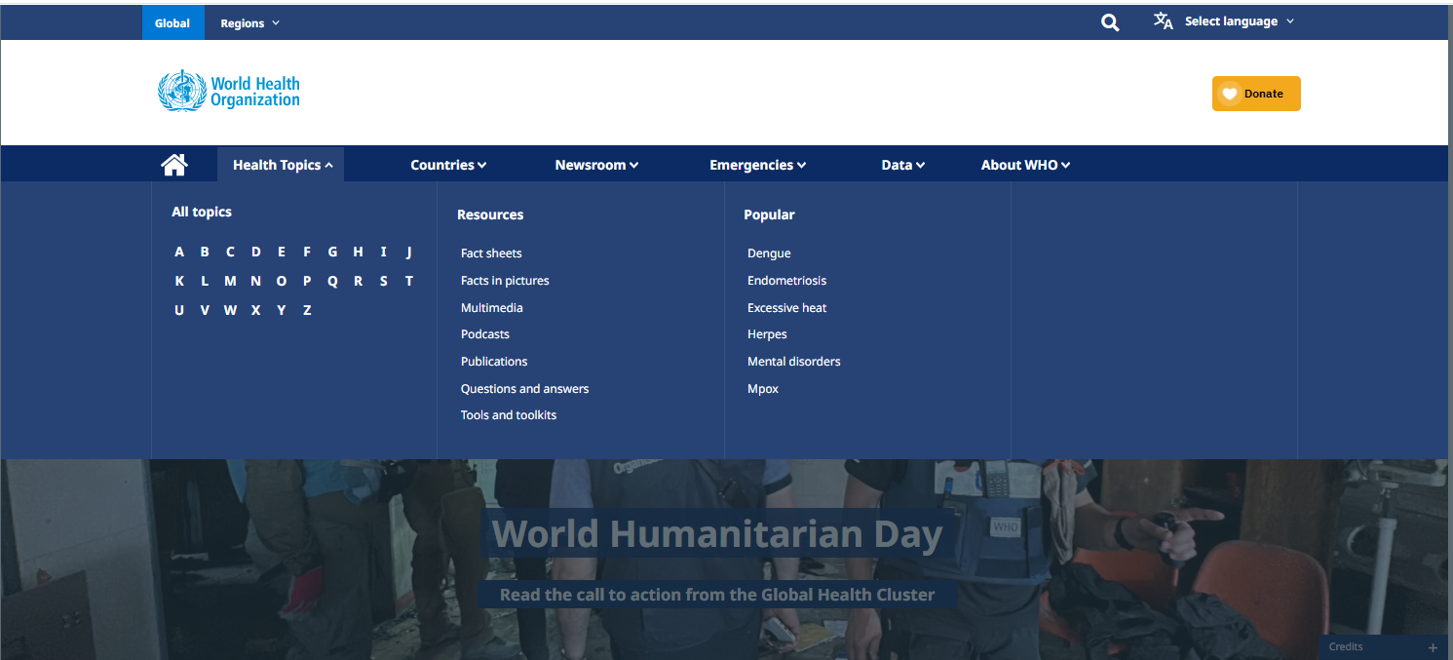
WHO website
https://www.who.int/
Notes:
At the top of the page are different tabs. When you click on each tab, you will find different options. For example, clicking the Health Topics tab will give you the option to search different topics in alphabetical order, or search according to resources- fact sheets, publications etc or according to the trending topics as shown in the slide.

Slide 6
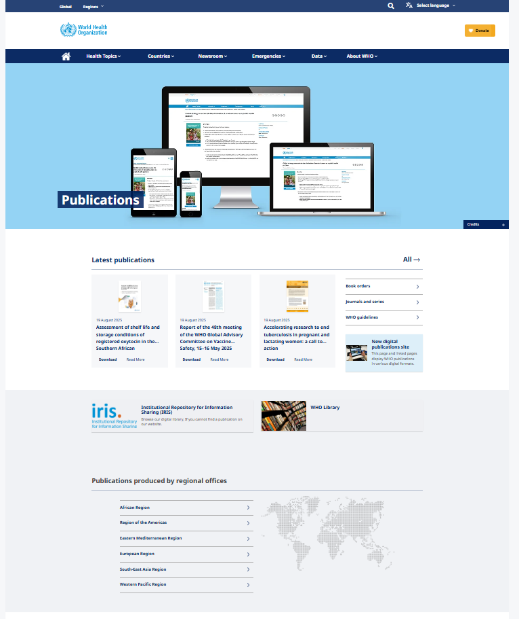
WHO website
Notes:
Clicking on the Health Topics tab also brings up the ‘Resources’ tab where various WHO resources are listed. From the list, click on ‘Publications’. This will lead you to a webpage with links to various WHO publications including guidelines, journals and series, to the WHO online bookshop and to the new digital publications site. You will also find direct links to Institutional Repository for Information Sharing (IRIS) which we will look at later, the WHO Library and publications by the WHO Regional offices.

Slide 7
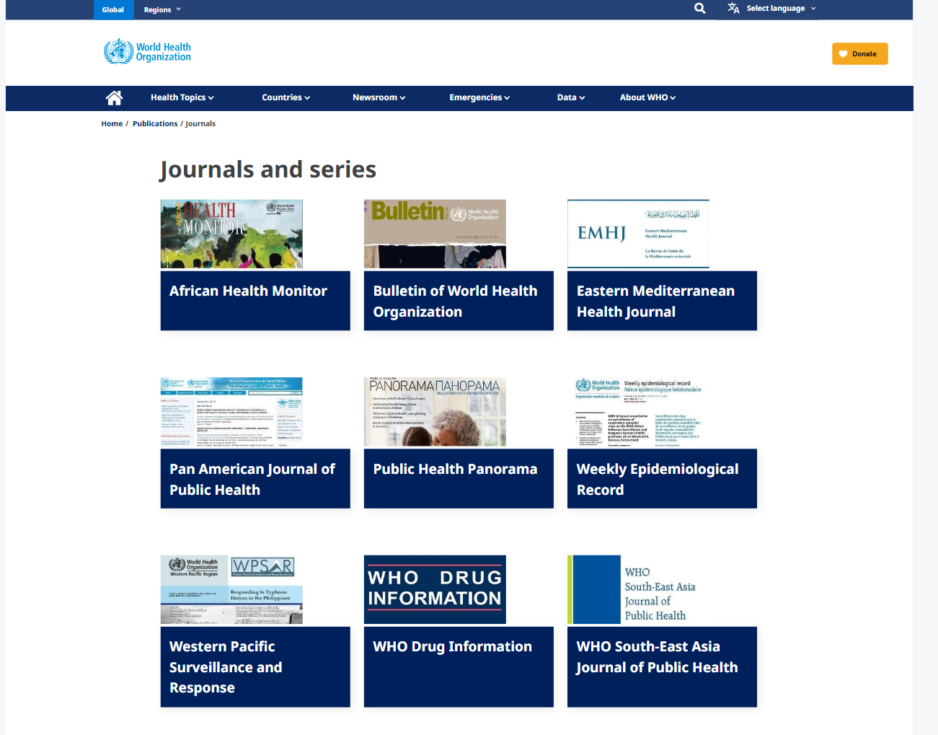
WHO website
Notes:
From the ‘Publications’ page, click on ‘Journals and series’ from the options provided. Here, you can access the WHO Bulletin and other journals.

Slide 8
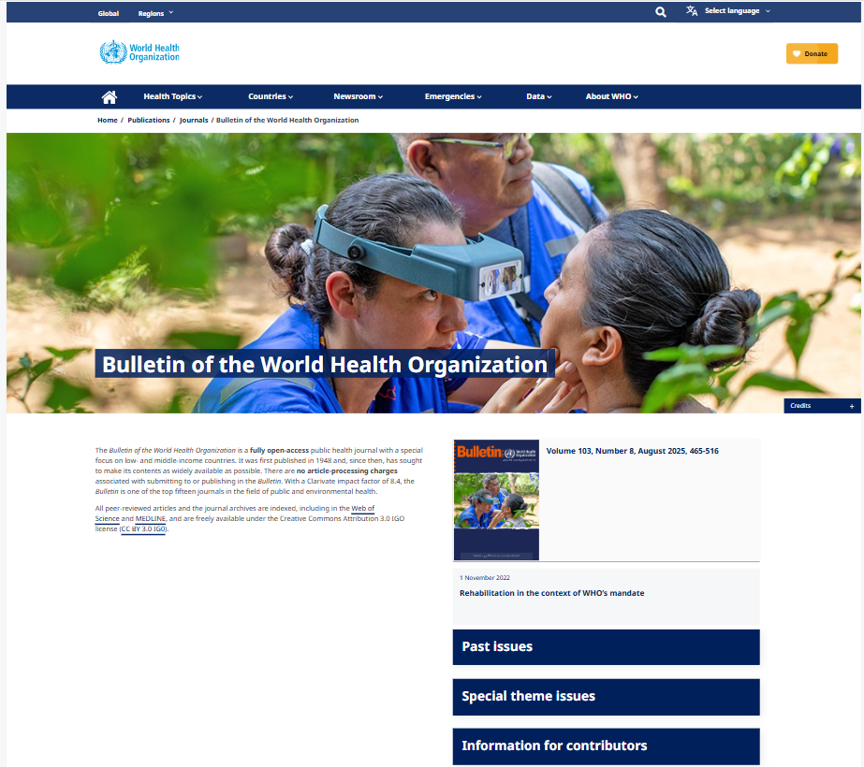
WHO website
The Bulletin of the World Health Organization
A fully open-access journal of public health with a special focus on low and middle-income countries, first published in 1948.
There are no article-processing charges associated with submitting to, or publishing in the Bulletin.
All peer-reviewed articles and the journal archives are indexed, including in the Web of Science and MEDLINE, and are freely available under the Creative Commons Attribution 3.0 IGO license (CC BY 3.0 IG0).
Notes:
The Bulletin of the World Health Organization is a fully open-access journal of public health.
It focuses specially on low- and middle-income countries.
It was first published in 1948 and, since then, it has sought to make its full contents as widely available as possible.
There are no article-processing charges associated with submitting to, or publishing in the Bulletin. This is of particular note to researchers in low- and middle- income countries.
With a Clarivate impact factor of 8.4, the Bulletin is one of the top fifteen journals in the field of public and environmental health.
All peer-reviewed articles and the journal archives are indexed, including in the Web of Science and MEDLINE, and are freely available under the Creative Commons Attribution 3.0 IGO license (CC BY 3.0 IG0).
You can click on ‘Past issues’ on the right side of the page to browse and read previous editions of the bulletin.
You will find all the information you need to submit an article for publication in the Bulletin by clicking on ‘Information for contributors’.
You will find some general information at the bottom part of the webpage, including information on contacts for enquiries, registering for email alerts, subscribing or ordering journals, editorial members etc.

Slide 9
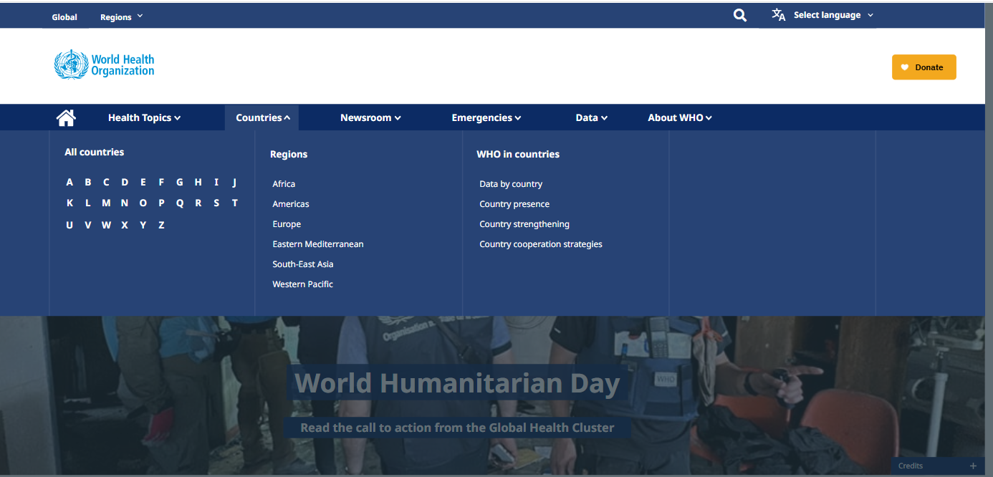
WHO website
https://www.who.int/
Notes:
By clicking on the ‘Countries’ tab, you can search for information by country in alphabetical order or by WHO region.

Slide 10
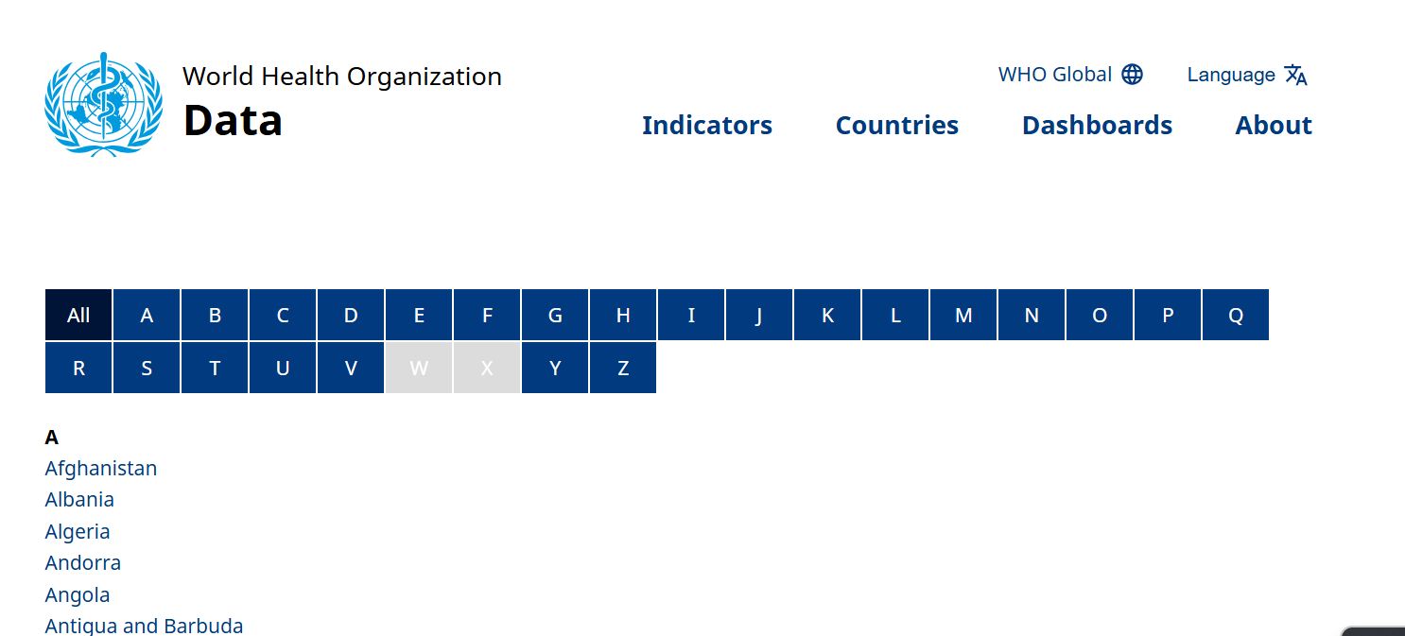
WHO website
https://www.who.int/
Notes:
By clicking on the ‘Countries’ tab, you will also find the ‘WHO in countries’ menu with links to various country information including data.
Clicking on ‘Data by country’ will take you to the ‘WHO Data’ page which is a database of health statistics on different health indicators for different countries. You can search for data by indicator or by country.

Slide 11
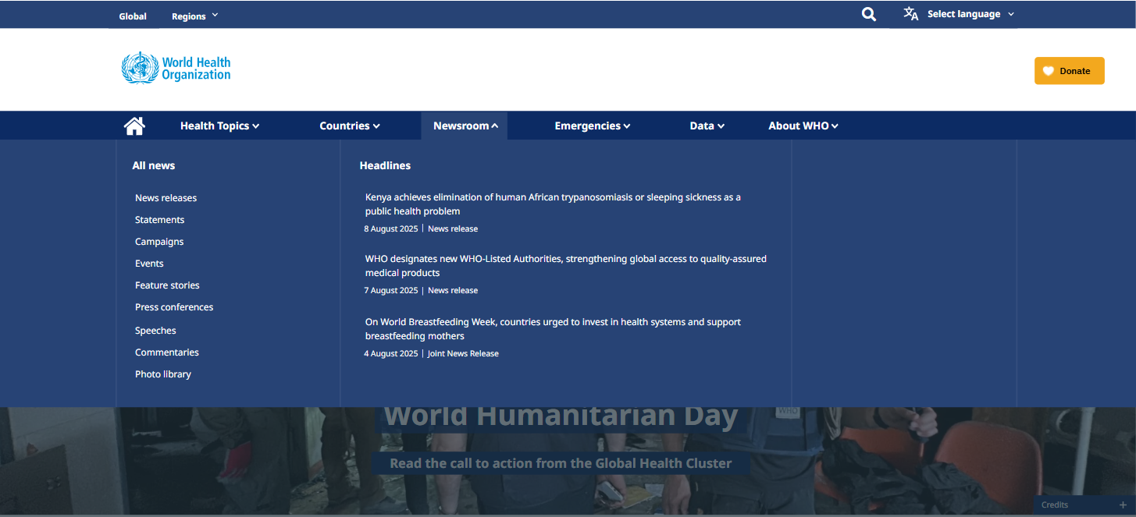
WHO website
https://www.who.int/
Notes:
Click on ‘Newsroom to find links to all news – WHO statements, events, campaigns etc. You will also see headlines on current news and events.

Slide 12
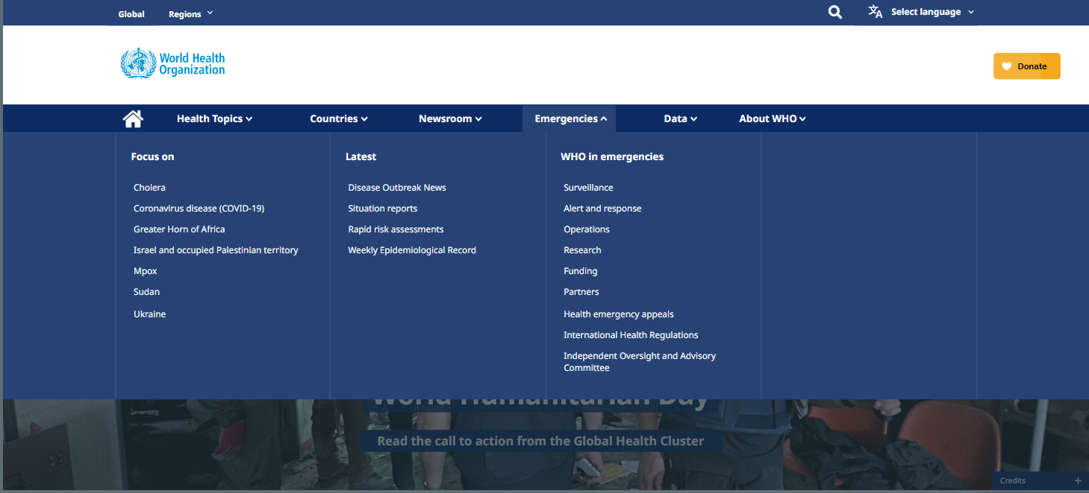
WHO website
https://www.who.int/
Notes:
The ‘Emergencies’ tab will give you links to information on crisis / disaster zones across the world and WHO activities in these areas.

Slide 13
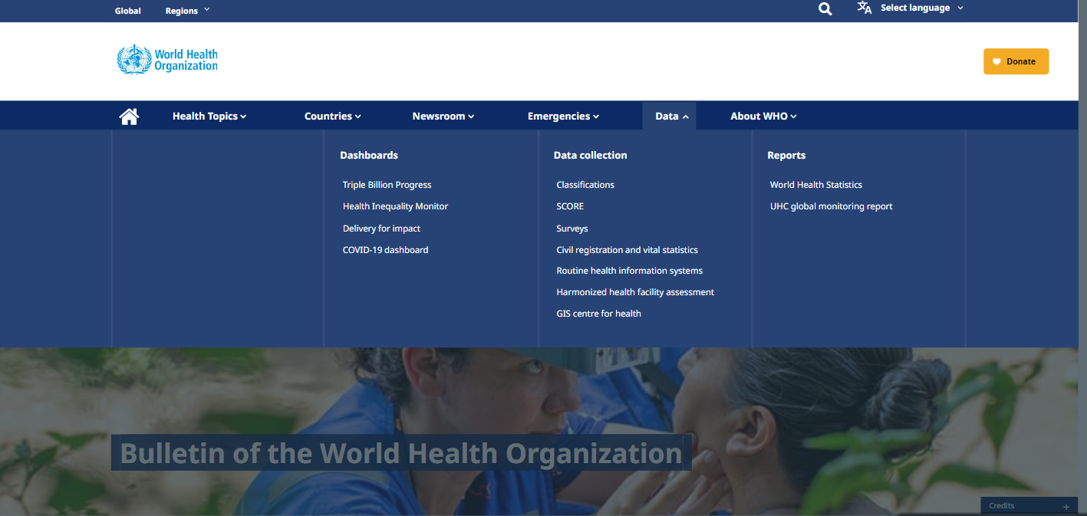
WHO website
https://www.who.int/
Notes:
The ‘Data’ tab provides access to various data sources including the World Health Statistics under ‘Reports’. Clicking on this will take you to a page where you can download World Health Statistics reports in the ‘Global Health Observatory’ site (see next three slides).

Slide 14
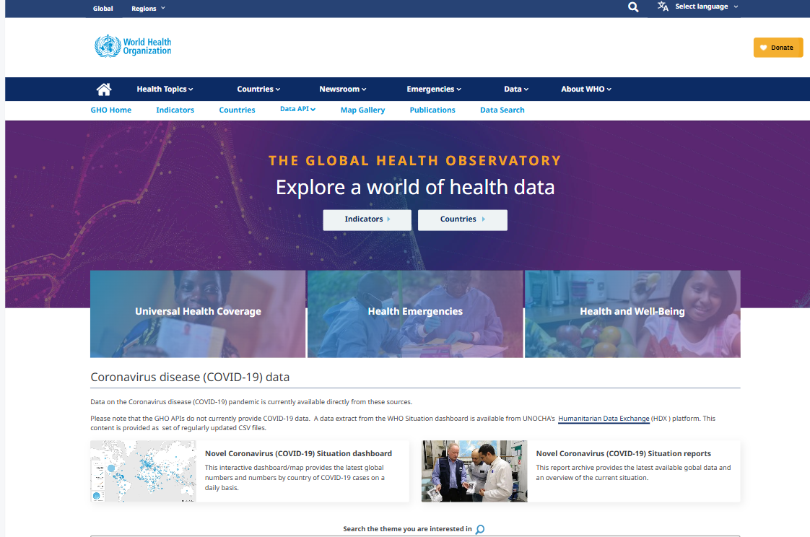
WHO website
The Global Health Observatory
https://www.who.int/
Notes:
The ‘Global Health Observatory’ is a very useful database for information on indicators and statistics on different health issues across the globe. You can find information by indicators or by countries.

Slide 15
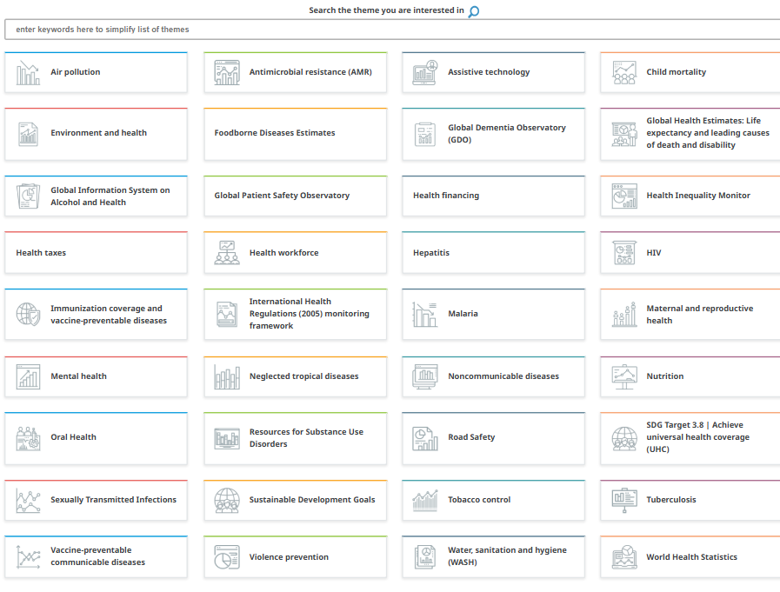
WHO website
The Global Health Observatory
https://www.who.int/
Notes:
You can also search for information by themes.

Slide 16
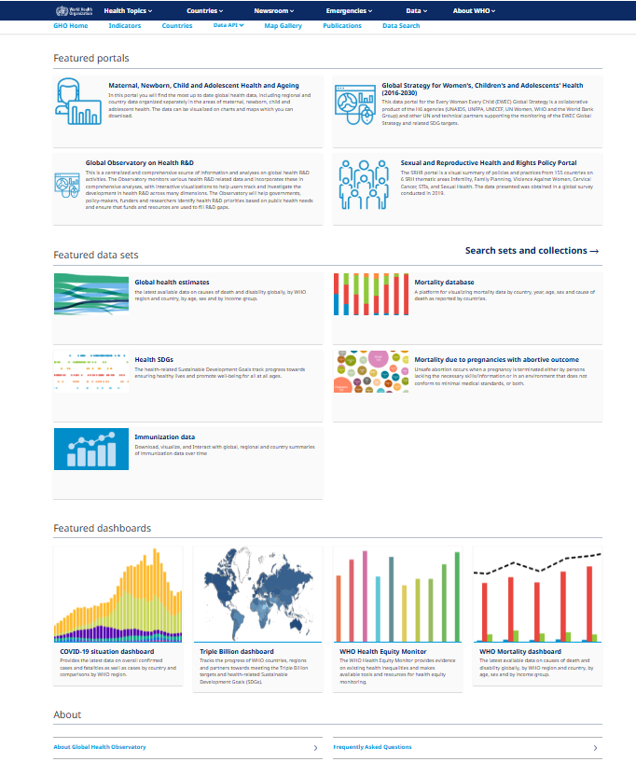
WHO website
The Global Health Observatory
https://www.who.int/
Notes:
In the lower half of the webpage, you have links to different portals, data sets and dashboards.

Slide 17
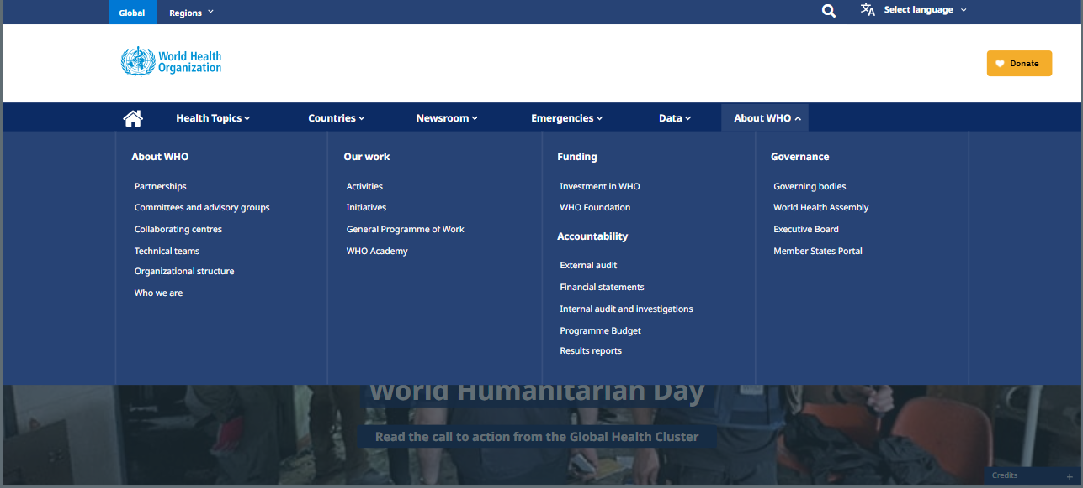
WHO website
https://www.who.int/
Notes:
The ‘About WHO’ tab provides links to information about WHO, its activities, funding and governance which includes the World Health Assembly.

Slide 18
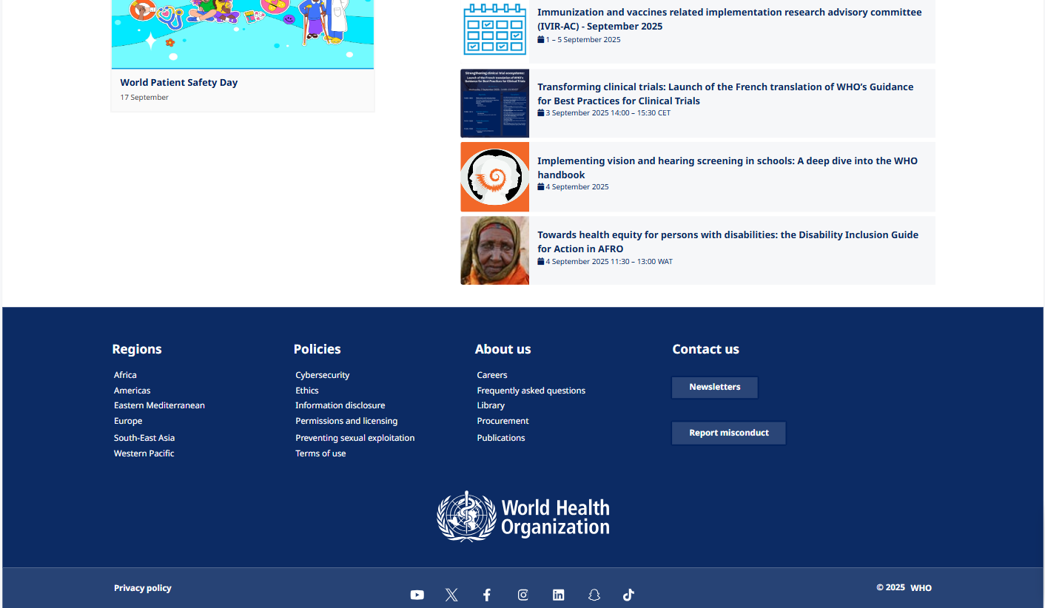
WHO website
https://www.who.int/
Notes:
At the bottom of the WHO website homepage, are links to the websites of the WHO Regional offices as well as to the WHO Library.
Click on the Library link to access the page: https://www.who.int/library

Slide 19
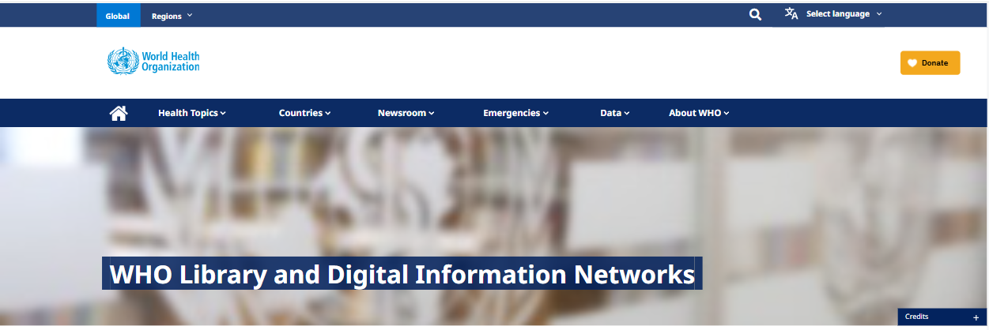
WHO Library
https://www.who.int/library
The world’s leading library on public health.
It provides access to knowledge from WHO as well as to other sources of scientific literature produced around the world.
WHO library resources and expertise provide scientific evidence and knowledge to low- and middle- income countries through a set of low-cost/high-use initiatives.
Notes:
The WHO Library is available at: https://www.who.int/library
It provides access to scientific literature from all around the world.
Focuses on adequate and cost-effective information and knowledge sharing solutions.

Slide 20
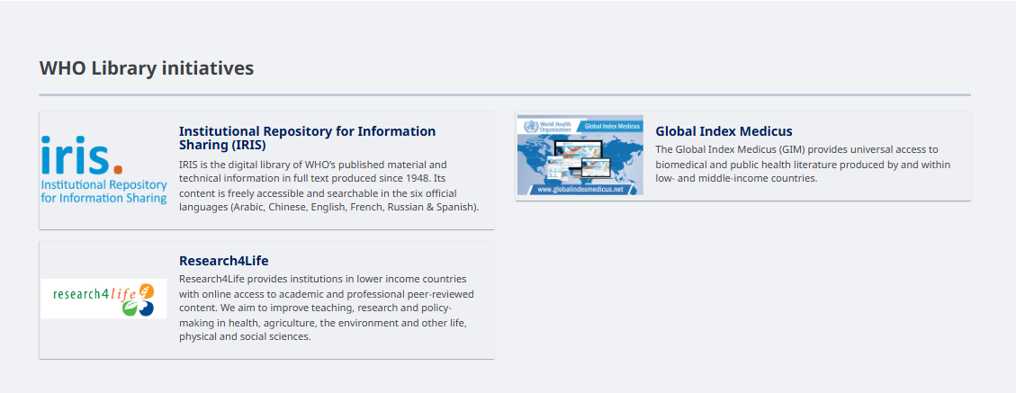
WHO Library initiatives
Institutional Repository for Information Sharing (IRIS) https://iris.who.int/
Global Index Medicus https://www.globalindexmedicus.net/
Research4Life https://www.research4life.org/
Notes:
WHO Library initiatives include:
Institutional Repository for Information Sharing (IRIS) https://iris.who.int/
Global Index Medicus https://www.globalindexmedicus.net/
Research4Life https://www.research4life.org/

Slide 21
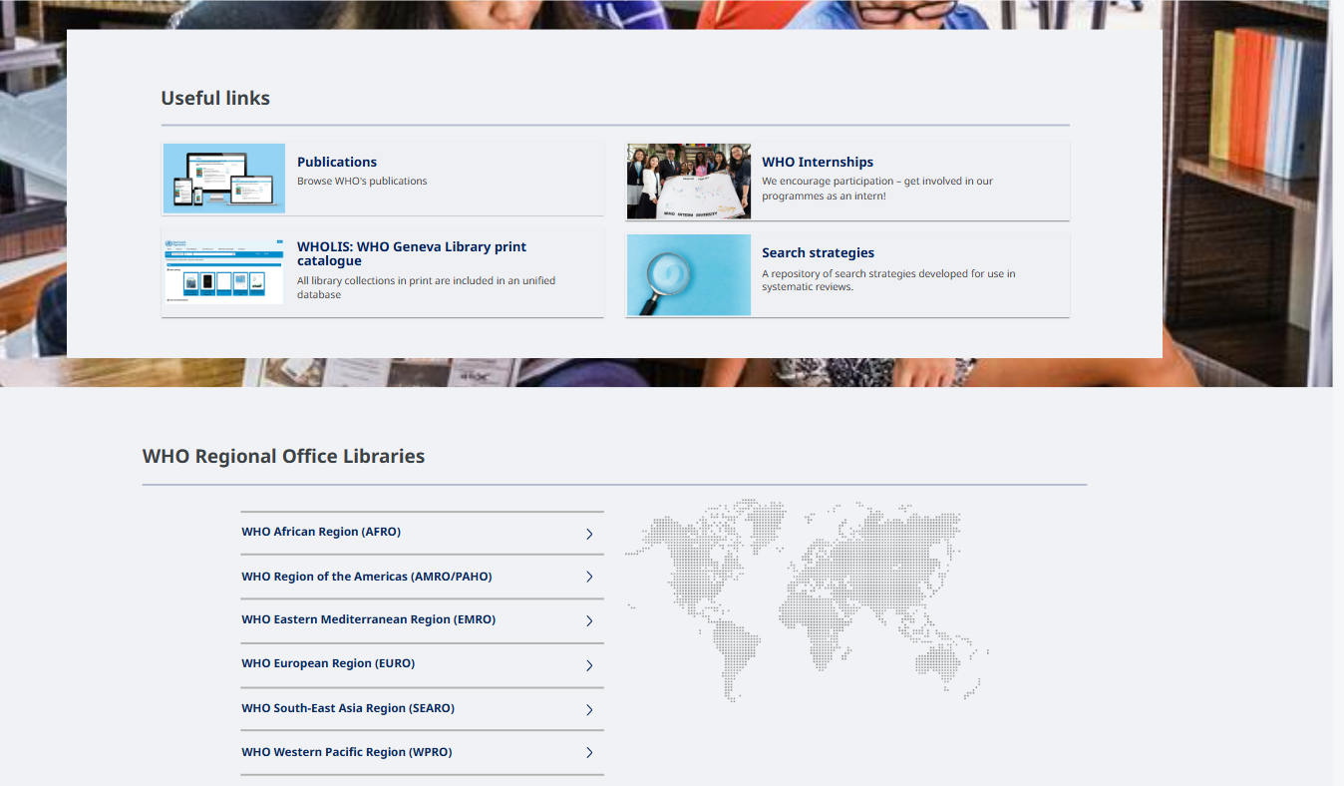
WHO Library: Useful links
Notes:
At the bottom part of the WHO Library webpage are useful links to:
WHO publications (https://www.who.int/publications)
WHOLIS: WHO Geneva Library print catalogue (http://kohahq.searo.who.int/)
WHO Internships
Search strategies
WHO regional office libraries

Slide 22
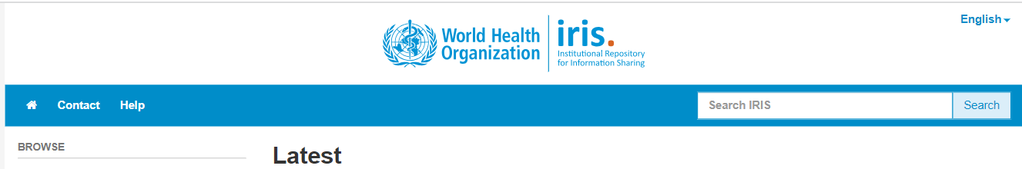
Institutional Repository for Information Sharing (IRIS)
Accessible from: https://iris.who.int/
Digital library of WHO’s published material and technical information in full text produced since 1948
Freely accessible and searchable content in the six official languages (Arabic, Chinese, English, French, Russian & Spanish)
Information can be browsed by communities & collections, issue date, authors, titles, subjects, countries or the most popular subject
Watch the following video guides:
New IRIS interface – quick tour (1:13 mins)
How to search in IRIS - quick tour (2.28 mins)
IRIS statistics - quick tour (2.19 mins)
Notes:
IRIS is the digital library of WHO’s published material and technical information in full text produced since 1948. It is searchable in six different languages (Arabic, Chinese, English, French, Russian & Spanish) and be browsed by various subjects.
Watch the video guides in the slide to learn how to search in IRIS.

Slide 23
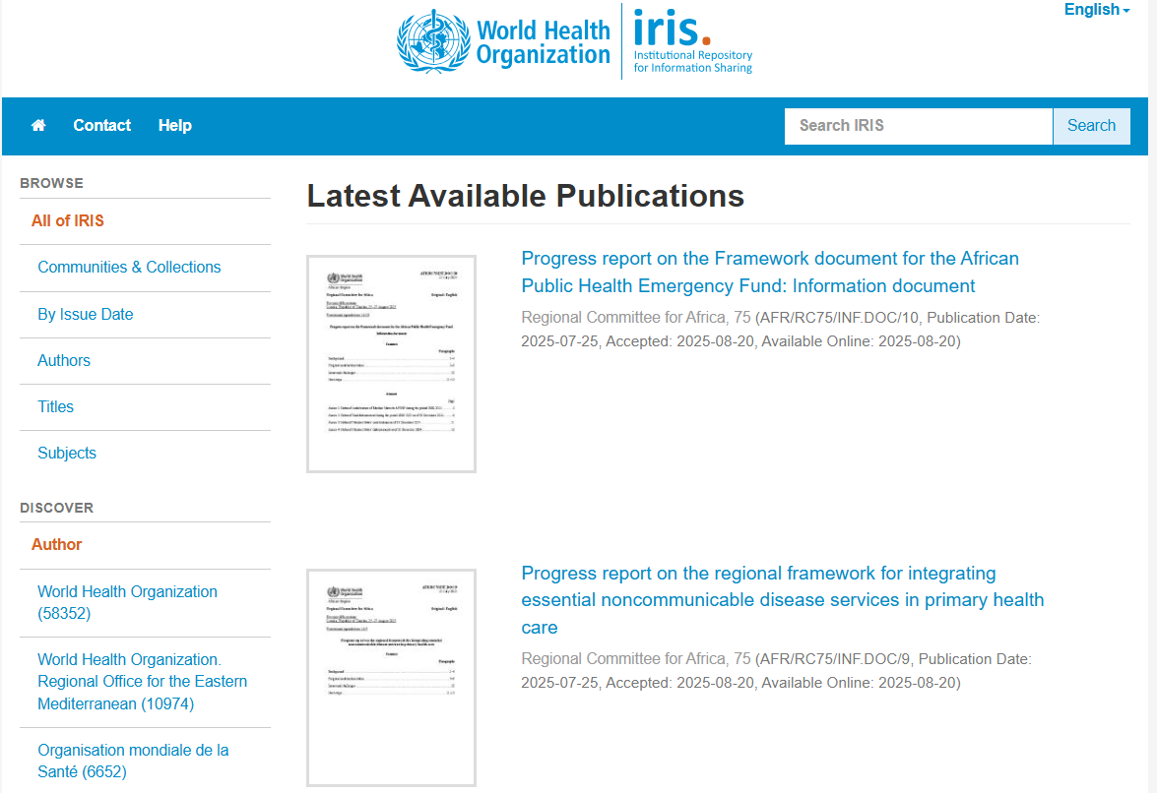
Institutional Repository for Information Sharing (IRIS)
https://iris.who.int/
Notes:
You can browse for information under the various headings on the left. You can also input key words in the search option. Please watch the video guides in the previous slide to learn more.

Slide 24
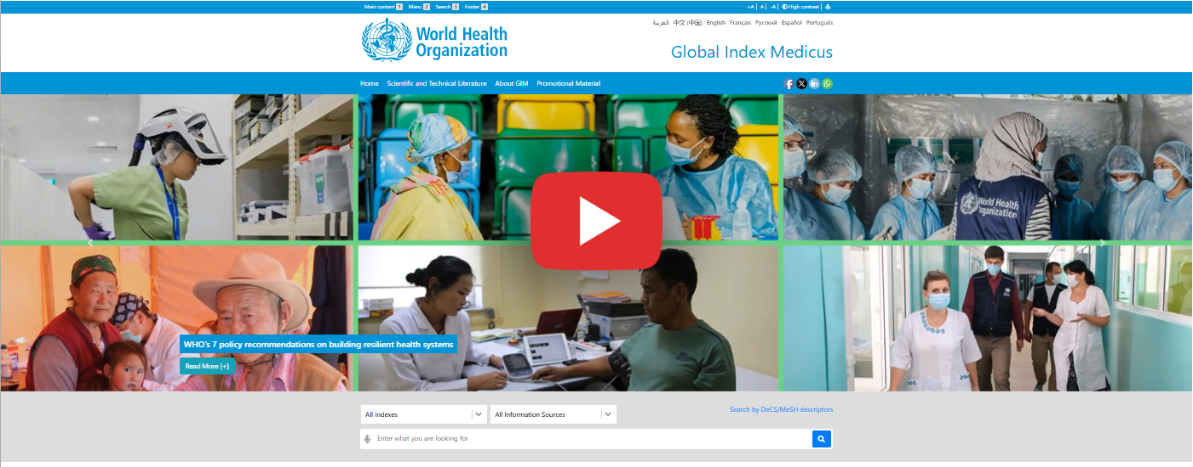
Global Index Medicus (GIM)
https://www.globalindexmedicus.net/
Provides universal access to biomedical and public health literature produced by and within low- and middle-income countries.
Main objective is to increase the visibility and usability of these resources.
Material is collated and aggregated by WHO Regional Office Libraries on a central search platform allowing retrieval of bibliographical and full text information.
Read the GIM search quick guide
Notes:
GIM is a database of biomedical and public health literature from low- and middle-income countries to make them more visible and useable. It can be accessed from: https://www.globalindexmedicus.net/
Please read the GIM search quick guide to know how to search for literature on the website: https://www.globalindexmedicus.net/wp-content/themes/globalindexmedicus/img/guiaen.pdf

Slide 25
Global Index Medicus (GIM)
https://www.globalindexmedicus.net/
All information from the Regions can be found in the same search interface.
Also possible to access them individually from the Regional Indexes Medici:
  African Index Medicus – AIM (AFRO/WHO)
  Scientific and Technical Literature of Latin America and the Caribbean – LILACS (AMRO-PAHO/WHO, by its specialized center BIREME)
  Index Medicus for Eastern Mediterranean Region – IMEMR (EMRO/WHO)
  Index Medicus for South-East Asia Region – IMSEAR (SEARO/WHO)
  Western Pacific Region Index Medicus – WPRIM (WPRO/WHO)
Notes:
The general search interface (http://search.bvsalud.org/gim) can be used to access information from all the Regions.
Information can also be accessed by directly clicking on the link for individual Regional Index Medicus.

Slide 26
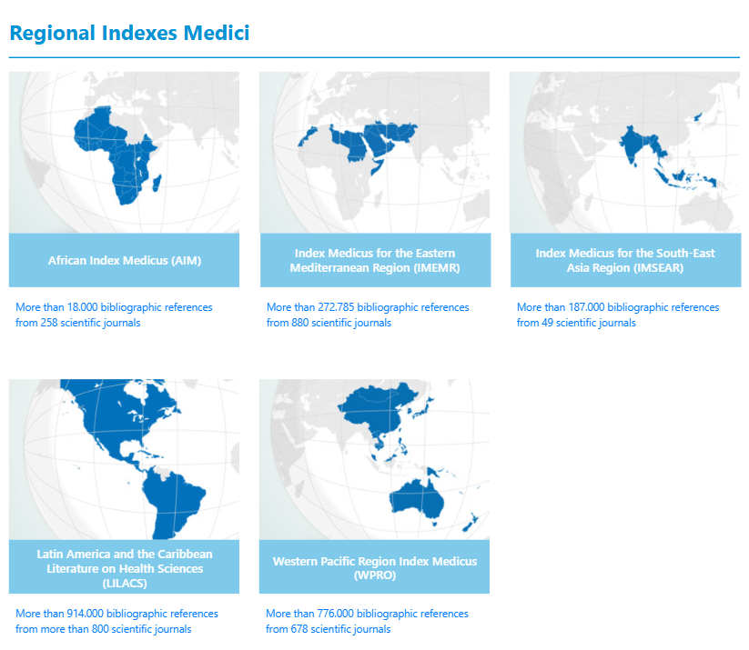
Global Index Medicus (GIM)
https://www.globalindexmedicus.net/
More than 1.9 million of documents available in all Regional Indexes Medici together, of which more than 1 million have full text access.
Notes:
The main contents of the GIM are the millions of documents from all the Regional Indexes Medici.
There is full text access to over a million of them.

Slide 27
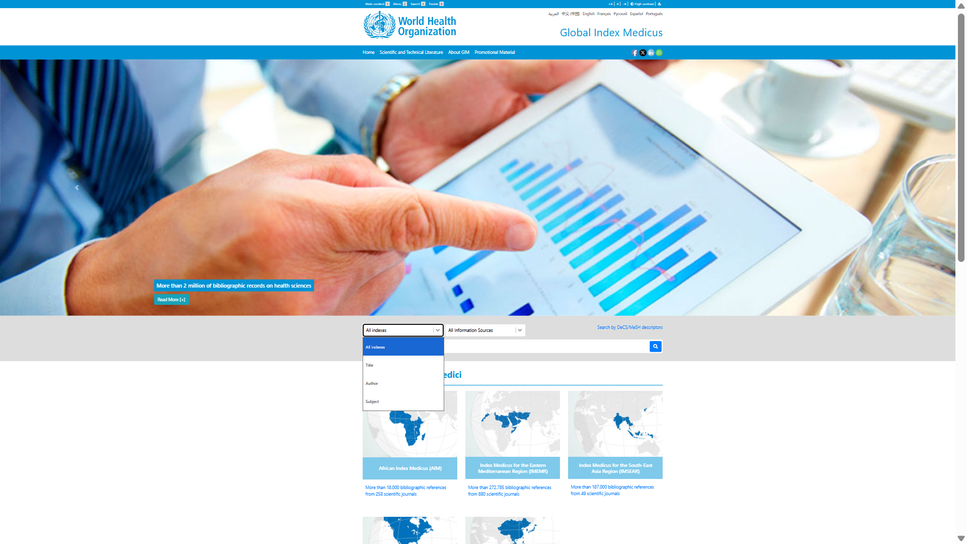
Global Index Medicus (GIM)
https://www.globalindexmedicus.net/
Menu: search by title, author or subject
Notes:
Click on ‘All indexes’ to search by title, author or subject.
You can find out more in the the GIM search quick guide. https://www.globalindexmedicus.net/wp-content/themes/globalindexmedicus/img/guiaen.pdf

Slide 28
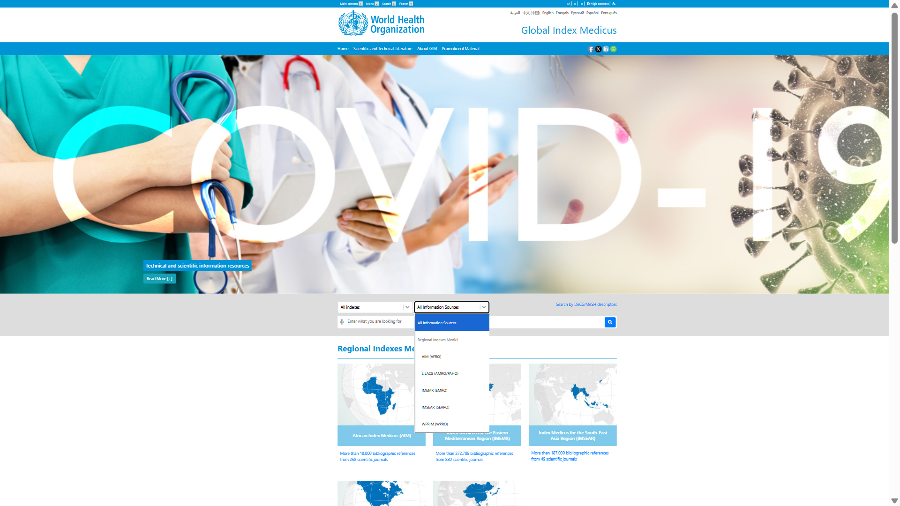
Global Index Medicus (GIM)
https://www.globalindexmedicus.net/
Menu: search by information sources
Notes:
Click on ‘All Information Sources’ to search individual Regional Index Medicus. Find out more in the the GIM search quick guide.

Slide 29
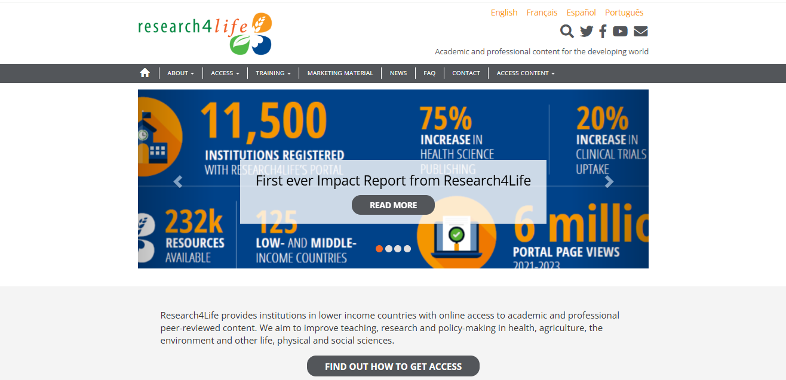
Research4Life
https://www.research4life.org/
Provides institutions in lower income countries with online access to academic and professional peer-reviewed content.
The aim is to improve teaching, research and policy-making in health, agriculture, the environment and other life, physical and social sciences.
Notes:
Research4Life provides institutions in lower income countries with online access to academic and professional peer-reviewed content.
The aim is to improve teaching, research and policy-making in health, agriculture, the environment and other life, physical and social sciences.
Since 2002, Research4Life has provided researchers at more than 11,500 institutions in over 125 lower- and middle-income countries with free or low-cost online access to up 203,000 leading journals and books in the fields of health, agriculture, environment, applied sciences and legal information.
Partnership with organizations in the fields of scholarly communications, technology and international development: WHO, FAO, UNEP, WIPO, ILO; Cornell and Yale Universities; the International Association of Scientific, Technical & Medical Publishers and more than 200 international publisher partners.
There are five content collections:
Research for Health (Hinari) https://www.research4life.org/about/programs/hinari/
Research in Agriculture (AGORA)
https://www.fao.org/agora/
Research in the Environment (OARE) https://www.unenvironment.org/explore-topics/environment-under-review/what-we-do/information-management/online-access-research
Research for Development and Innovation (ARDI) http://www.wipo.int/ardi/en/
Research for Global Justice (GOALI)
http://www.ilo.org/goali

Slide 30
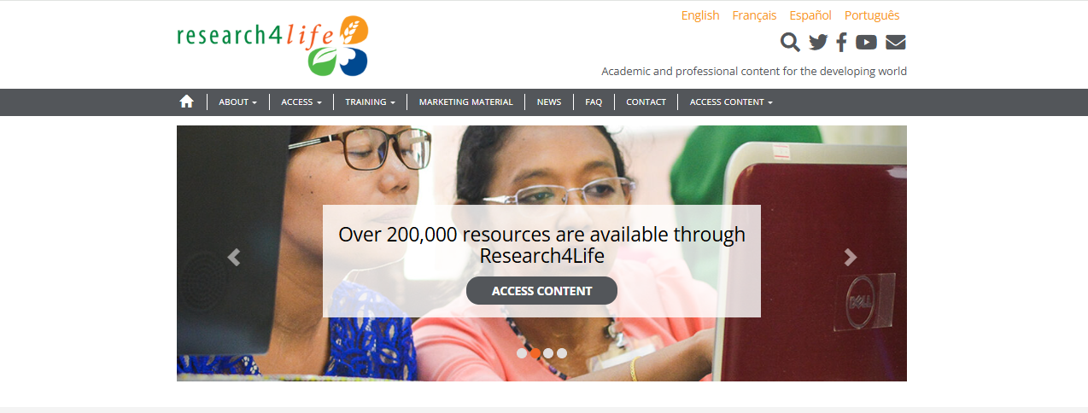
Accessing Research4Life
https://www.research4life.org/
Only institutions are eligible to register for access; individuals are not.
An academic, government or research institution in a low- and middle-income country may be eligible to join Research4Life.
Learn more about the Eligibility for access to Research4Life and the Eligibility criteria.
Learn how to search the Research4Life Unified Content Portal.
Using Research4Life and the wider scholarly communications landscape.
Quick videos: Introduction to Research4Life, New Research4Life Portal | Getting started, How to register to Research4Life.
Notes:
Local, not-for-profit institutions from two groups of eligible countries, areas and territories (https://www.research4life.org/eligibility) may register for free or low-cost access to ten of thousands of peer-reviewed international scientific journals, publications, and databases through Research4Life.
If your institution is an academic, government or research institution in a low- and middle-income country, it may be eligible to join Research4Life.

Slide 31
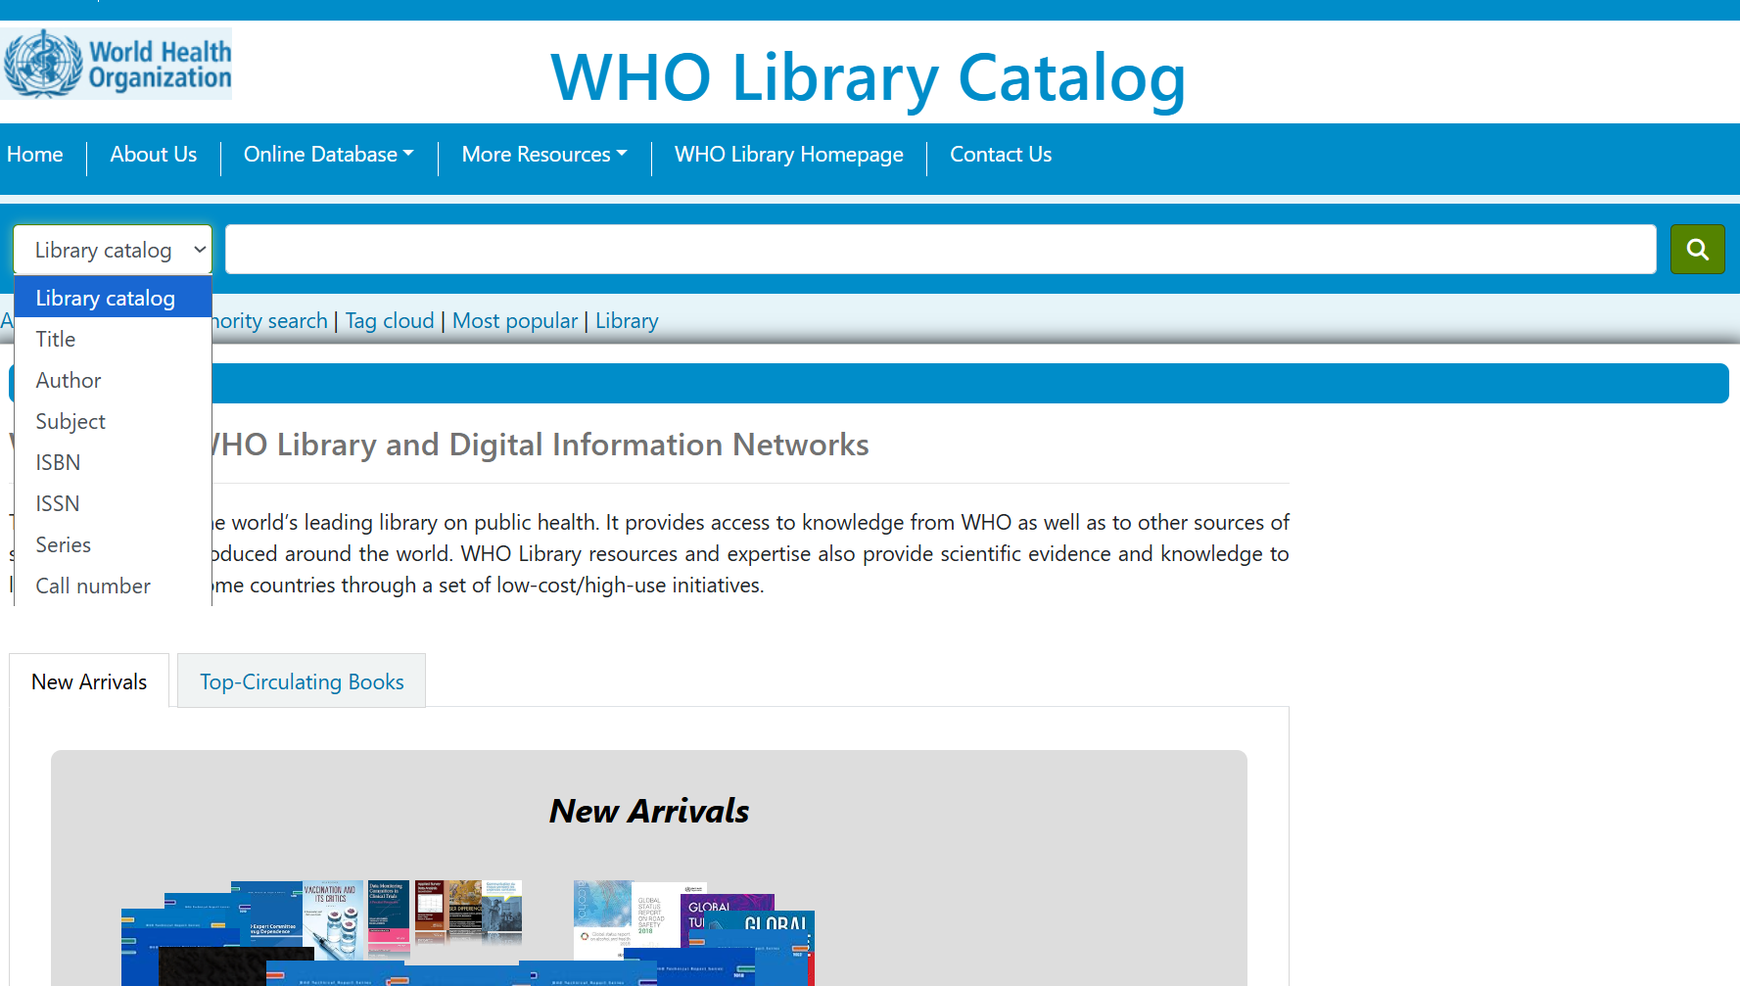
WHOLIS: WHO Geneva Library print catalogue
https://kohahq.searo.who.int/
Contains all library collections in print in a unified database.
Notes:
In the WHOLIS: WHO Geneva Library print catalogue, all library collections in print are included in a unified database.
A search can be conducted using the various search options.
You can create an account and save your search results.

Slide 32
WHO Regional office libraries
WHO African Region (AFRO)
WHO Region of the Americas (AMRO/PAHO)
WHO Eastern Mediterranean Region (EMRO)
WHO European Region (EURO)
WHO South-East Asia Region (SEARO)
WHO Western Pacific Region (WPRO)

Slide 33
Other information sources
BIGG – International database of GRADE guidelines
Epistemonikos – Combines the best of Evidence-Based Health Care, information technologies and a network of experts to provide a unique tool for people making decisions concerning clinical or health-policy questions
Hinari – Access to Research for Health programme
PAHO IRIS – Institutional Repository of PAHO/WHO
Pubmed – Comprises more than 29 million citations for biomedical literature from MEDLINE, life science journals, and online books. Citations may include links to full-text content from PubMed Central and publisher web sites.
RedETSA/BRISA – Regional Base of Health Technology Assessment Reports of the Americas
SciELO – Scientific Electronic Library Online.
Virtual Health Library (VHL) – A model, strategy, and operational platform for information management, coordinated and promoted by the Latin American and Caribbean Center on Health Sciences Information (BIREME/PAHO/WHO).
WHO video channel

Slide 34
WHO Library contact
World Health Organization
WHO Library and Digital Information Networks
Avenue Appia 20
1211 Geneva 27
Switzerland
Telephone: +41(0)22 791 2062
Email: library@who.int
You can also use the WHO Library research/information request form available at: https://extranet.who.int/dataformv3/index.php/282679?lang=en
Notes:
For any query or support, you can contact the Library team at the address on the slide.

Slide 35

Thank you!

