Slide 1
Implementation Research
Dr Melaku Samuel (MD, MSc, PhD candidate),
Ambaw Belete (BA, MA, PGD)
Training course in research methodology, research protocol development and scientific writing Geneva 2024

Slide 2
Learning outcomes:
By the end of the presentation, you should be able to:
Define implementation research (IR): what it is and how to conduct it
Understand why research on implementation is needed and how it is used
Identify who should be involved in implementation research
Describe appropriate approaches and methods for implementation research
Understand the importance of doing need-based implementation research
Discuss the challenges faced by implementation research and actions required for its realization

Slide 3
Acknowledgment
This presentation was adapted mainly from: Peters DH, Tran N, Adam T, Ghaffar A. Implementation research in health: a practical guide. Alliance for Health Policy and Systems Research, World Health Organization; 2013. https://apps.who.int/iris/bitstream/handle/10665/91758/9789241506212_eng.pdf

Slide 4
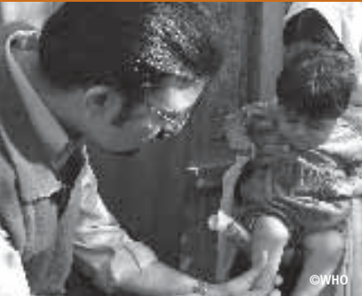
What is implementation research (IR)?
Implementation (practice) is the act of carrying an intention into effect, which in health can be policies, programs, or individual practices (collectively called interventions):
Example: the act of administering misoprostol for active management of the third stage of labour (AMTSL)
Implementation research (IR) is the scientific inquiry into questions concerning implementation:
Example: study on the acceptability of misoprostol among pregnant women in an area

Slide 5
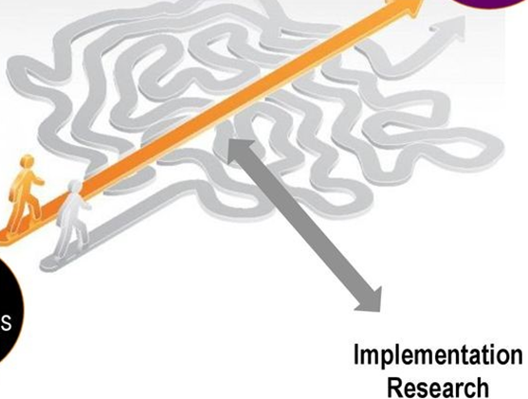
What is implementation research? cont’d
Figure 1: Implementation research helps narrow the “know-do” gaps (Adapted from: https://slideplayer.com/slide/14535022/ )
Policy, program, intervention outcomes
Policy, program, intervention objectives

Slide 6
What is implementation research? cont’d
IR can consider any aspect of implementation, including the factors affecting implementation, the processes of implementation, and the results of implementation, including how to introduce potential solutions into a health system or how to promote their large scale use and sustainability
The basic intent of IR is to understand not only what is and is not working, but how and why implementation is going right or wrong, and testing approaches to improve it

Slide 7
Implementation research vs. other research domains
Research Domain
Operational research (OR): aims to develop solutions to current operational problems of specific health programs or specific service delivery components of the health system
Implementation research (IR): aims to develop strategies for available or new health interventions in order to improve access to, and the use of, these interventions by the populations in need
Health systems research (HSR): addresses health system and policy questions that are not disease-specific but concern systems problems that have repercussions on the performance of the health system as a whole

Slide 8
Implementation research vs. other research domains cont’d
Examples of research questions for the 3 research domains:
Operational
Which locations should be targeted for delivering male circumcision (MC) services in Eastern Africa?
Implementation
How can access to MC services among populations who are currently not reached by MC services be improved?
Health System
What has been the impact of the rapid scale-up of MC program on fragile health system?

Slide 9
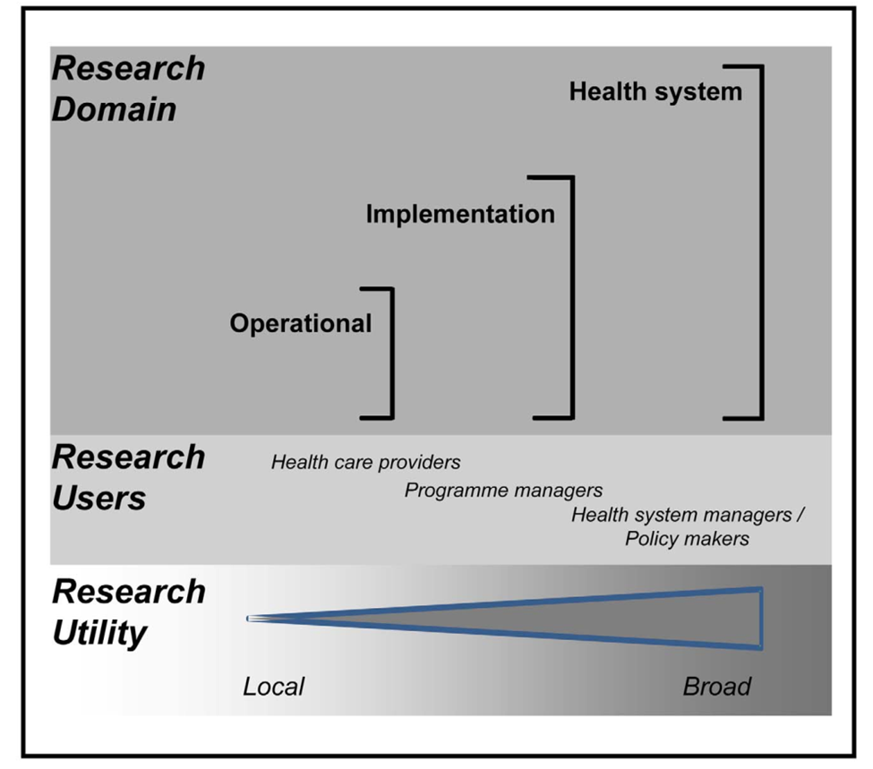
Implementation research vs. other research domains cont’d
Figure 2: Research to improve health system (Source: Remme JH, Adam T, Becerra-Posada F, D'Arcangues C, Devlin M, Gardner C, Ghaffar A, Hombach J, Kengeya JF, Mbewu A, Mbizvo MT, Mirza Z, Pang T, Ridley RG, Zicker F, Terry RF. Defining research to improve health systems. PLoS Med. 2010 Nov 16;7(11):e1001000.)

Slide 10
Implementation research vs. other research domains cont’d
What makes IR different?
Focuses on implementation (vs. impact)
Focuses on complex real world contexts (vs. controlled settings)
Is shaped by implementers and stakeholders (vs. researchers)
Is highly practical and action-oriented (vs. theoretical)
Uses mixed methods
Looks at underlying implementation outcomes (vs. service or health outcomes): for example, the focus is on feasibility or fidelity, and not on population health outcomes
Is designed to support policy and practices and not afraid of looking at failure

Slide 11
Implementation strategies
IR often focuses on the strategies needed to deliver or implement new interventions, which are referred to as ‘implementation strategies’-a term used to distinguish them from clinical and public health interventions:
Example, while outreach clinics and supervision checklists are implementation strategies commonly used to improve the coverage and quality of immunization programs, the provision of the vaccine itself is considered the health intervention
IR may focus on the implementation strategy itself, or incorporate consideration of the implementation strategy into a broader study of the health intervention

Slide 12
Implementation strategies cont’d
Implementation strategies grouped in terms of the actor or stakeholder using them
Government:
- Enhancing the capabilities of government (public policy, oversight and financing agencies)
Implementing/Provider Organization:
- Improving performance and accountability of organizations
Individual Providers/ health workers:
- Strengthening the capabilities and performance
Communities/households:
- Empowering communities and households
Multiple actors:
Supporting multiple stakeholders engaged in improving health

Slide 13
Implementation outcome variables
Describe the intentional actions to deliver services
Serve as indicators of how well a given implementation is actually working: useful for measuring success and failure of an implementation
The 8 implementation outcome variables– acceptability, adoption, appropriateness, feasibility, fidelity, implementation cost, coverage and sustainability– can also be seen as intermediate factors that contribute to other important outcomes such as satisfaction with health care or health status (health outcomes) (Table 1, next slide)

Slide 14
Implementation outcome variables cont’d
Table 1: Implementation outcome variables
Implementation Outcome | Working Definition | Related terms
Acceptability | The perception among stakeholders (for example, consumers, providers, managers, policy makers) that an intervention is agreeable | Factors related to acceptability: (e.g. comfort, relative advantage, credibility)
Adoption | The intention, initial decision, or action to try to employ a new intervention | Uptake, Utilization, Intention to try
Appropriateness | The perceived fit or relevance of the intervention in a particular setting or for a particular target audience (e.g. provider or consumer) or issue | Relevance, perceived fit, compatibility, perceived usefulness or suitability
Feasibility | The extent to which an intervention can be carried out in a particular setting or organization | Practicality, Actual fit, Utility, Suitability for everyday use

Slide 15
Implementation outcome variables cont’d
Table 1: Implementation outcome variables…
Implementation Outcome | Working Definition | Related terms
Fidelity | The degree to which an intervention was implemented as it was designed in an original protocol, plan, or policy | Adherence, delivery as intended, integrity, quality of program delivery, intensity or dosage of delivery
Implementation cost | The incremental cost of the delivery strategy (e.g. how the services are delivered in a particular setting). The total cost of implementation would also include the cost of the intervention itself | Marginal cost, total cost
Coverage (penetration) | The degree to which the population that is eligible to benefit from an intervention actually receives it. | Reach, Access, Service Spread or Effective Coverage, Penetration
Sustainably | The extent to which an intervention is maintained or institutionalized in a given setting | Maintenance, Continuation, Durability, Institutionalization, Routinization, Integration

Slide 16
Why is research on implementation needed?
A key challenge faced by the global health community is how to take proven interventions and implement them in the “real world”
Despite abundant evidence of the efficacy of affordable, life-saving interventions, there is little understanding of how to deliver those interventions effectively in diverse settings and within the wide range of existing health systems:
Example: ART program can prolong the lives of people living with HIV, but too often fail to ensure that everyone who needs treatment gets it.
Figure 3 (next slide) shows that less than 4% of women who tested positive for HIV during pregnancy in Zambia are actually initiated on ART in order to prevent mother-to-child transmission (PMTCT) of HIV

Slide 17
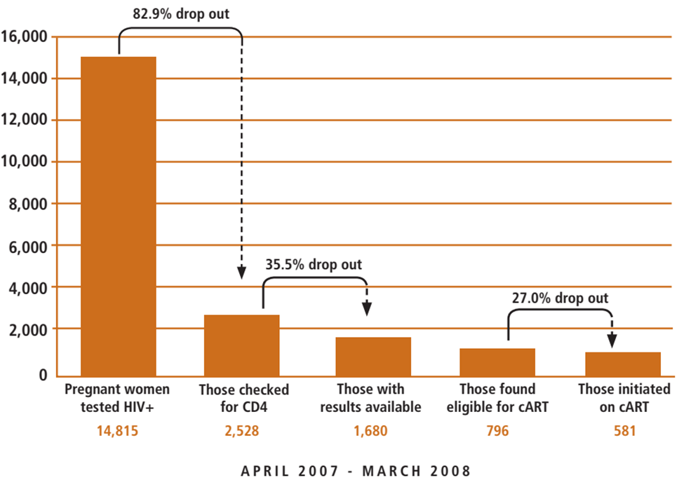
Why is research on implementation needed? cont’d
Figure 3: The Prevention of Mother-To-Child-Transmission (PMTCT) cascade in Zambia (2007-2008)
[Source: Mandala J, Torpey K, Kasonde P, Kabaso M, Dirks R, Suzuki C, Thompson C, Sangiwa G, Mukadi YD. Prevention of mother-to-child transmission of HIV in Zambia: implementing efficacious ARV regimens in primary health centers. BMC Public Health. 2009 Aug 27;9:314.]
Less than 4% of women who tested positive for HIV during pregnancy in Zambia are actually initiated on ART in order to prevent mother-to-child transmission (PMTCT) of HIV

Slide 18
Why is research on implementation needed? cont’d
Contribution to IR can be made by both people inside and outside academia: Very often it is the person in the field – the doctor in the remote rural clinic or the midwife working in the local community – who, facing some particular problem, asks the questions that are the starting point for new thinking
Implementation issues often arise as a result of contextual factors that policy-makers and health system managers may not even have considered:
Properly conducted IR, with its all-important focus on context can help implementers foresee and anticipate problems
It is because of its capacity to illuminate contextual issues that IR is such an important tool for implementers at the planning stage

Slide 19
Why is research on implementation needed? cont’d
IR has great benefits in reducing the gap between what can be achieved in theory and what happens in practice
IR as it relates to LMICs, where, despite abundant evidence of the efficacy of affordable, life-saving interventions, there is little understanding of how to deliver those interventions effectively:
Neglecting those implementation challenges costs lives and money (resources), especially in resource-poor settings
IR is a relatively new and somewhat neglected field: there is a need to define exactly what it is and what it can offer

Slide 20
How is implementation research used?
Implementation research (IR) takes what we know and turns it into what we do
Even when interventions are designed in similar ways, implementation occurs differently in different contexts, and with many different effects:
IR can offer crucial insights at several levels for implementers who, in general, recognize that implementation goes beyond simply reapplying the same template in country after country
IR is vital to understanding context, assessing performance, informing implementation and facilitating health systems strengthening:
Monitoring & Evaluation (M&E) activities play a significant part in this kind of IR, often helping to define important research questions

Slide 21
How is implementation research used? cont’d
IR is particularly important in supporting the scale-up of interventions and their integration into health systems at the national level:
Too often interventions that work in small-scale pilot studies fail to live up to expectations when rolled out in national strategies, or fail to transfer from one country to another as a result of contextual differences
IR not only helps to clarify why that happens, but can be used to support the process of re-iterative refinement needed for successful adaptation
IR is also important in quality improvement (QI) and health system (HS) strengthening:
IR can yield many benefits, but those benefits are maximized where research is answering the questions that decision-makers and practitioners are asking or should be asking.
IR can also be used to help organizations develop the capacity to learn:
A key driver of QI, and indeed of HS strengthening generally is the learning capacity of organizations

Slide 22
How is implementation research used? cont’d
To summarize, IR can be used to:
Assess change in real-world contexts, drawing on past experience, where appropriate;
Understand complex phenomena;
Generate and/or test new ideas; and
Predict, or at least help anticipate what may happen in the future as a result of a particular innovation or change
It also plays an important role in informing stakeholders, thereby improving understanding, transparency and accountability
Goal of IR is to make a difference, to improve the effectiveness, quality, efficiency and equity of policies, programs and services.

Slide 23
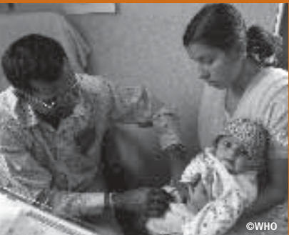
Who should be involved in implementation research?
One of the defining aspects of IR is that it seeks to understand the reality of implementation in real-world contexts:
Unlike other forms of research, it does not seek to filter out the extraneous or accidental; indeed, in many ways it is precisely such factors that are of interest to the implementation researcher
The considerations of context that are relevant to IR are illustrated in Figure 4 (next slide)
During the pre-implementation phase of an IR project, all contextual factors should be analyzed.
It should be noted that these factors vary considerably from one location to another, and from one project to the next
Understanding of context and systems, and the flexibility to identify appropriate methodological approaches, can be as important as or even more important than adherence to a fixed-research design

Slide 24
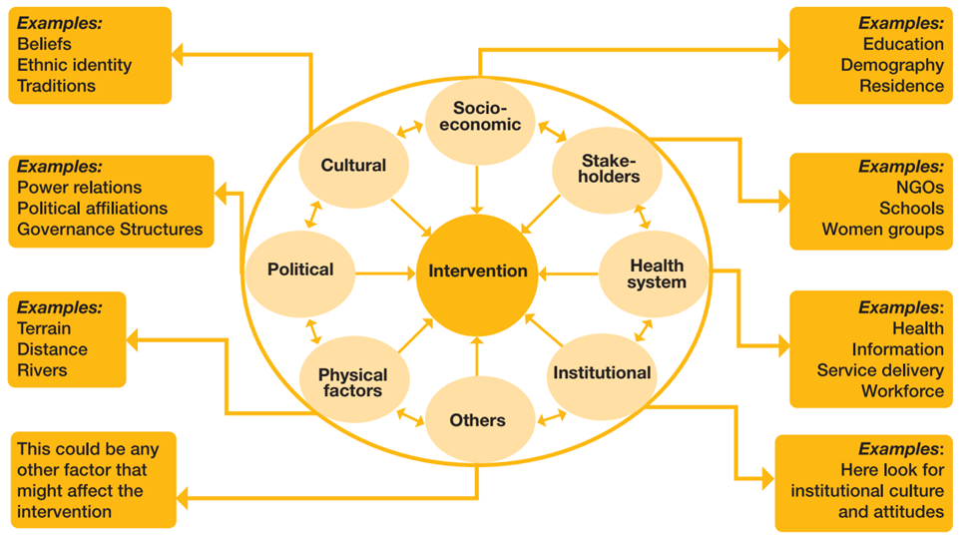
Who should be involved in implementation research? cont’d
Figure 4: Contextual factors for implementation research (Source: World Health Organization & UNICEF/UNDP/World Bank/WHO Special Programme for Research and Training in Tropical Diseases‎. Implementation research toolkit. World Health Organization; 2014.)

Slide 25
Who should be involved in implementation research? cont’d
Successful IR begins and ends with successful collaboration:
Good IR is collaborative research, and often most useful where implementers have played a part in the identification, design and conduct phases of the research undertaken
The fostering of collaborative ties between key stakeholders involved in policy generation, program management, and research is essential
IR is most likely to be useful to its audience where that audience is not just a passive recipient of results
The importance of both researchers and implementers coming together in the conduct of IR is of considerable importance in situations where the core issues relate to QI and the scale-up of a program, both of which impact many stakeholders
A symbiotic relationship – a relationship in which implementers generate feedback from the front lines, while researchers provide expertise in research methods is needed for trustworthy studies

Slide 26
How can IR can be embedded in the overall design, planning and decision making?
One way to improve collaboration and encourage partnerships in IR is to integrate it into policy and program decision-making:
Because IR often flows from well-established program activities and is of direct benefit to programs, it makes sense to include it as an integral part of program processes from the beginning rather than a tangential activity
IR needs to be embedded in the overall design, planning and decision-making endeavor. This can be achieved in 3 ways:
Integrating funding into research and program activities
The systematic application of research and scientific inquiry in program activities
Shared responsibility for decision-making

Slide 27
How can IR can be embedded in the overall design, planning and decision making? cont’d
Integrating funding into research and program activities:
Research funding generally flows through separate channels from program funding. As a result of this separation, research funding cycles are not always aligned with program needs
Similarly, a good deal of research is awarded on a competitive basis, whereas program funding typically is not competitive. This too creates mismatches between program needs and research objectives

Slide 28
How can IR can be embedded in the overall design, planning and decision making? cont’d
2) The systematic application of research and scientific inquiry in
program activities:
The systematic application of scientific research should be institutionalized within program decision making so that IR becomes a core part of the problem-solving process
The WHO/ExpandNET framework for scale-up is a useful example of how research and scientific inquiry can be integrated into processes (WHO, 2010)
The framework includes questions that need to be answered – sometimes through IR – as part of the nine steps that implementers need to consider when scaling-up a program
Another way in which research and scientific inquiry can be integrated into program decision-making is through mandatory M&E:
M&E helps to identify problems and challenges on a regular basis, some of which may be addressed through IR

Slide 29
How can IR can be embedded in the overall design, planning and decision making? cont’d
3) Shared responsibility for decision-making:
Implementers and researchers often come at problems from slightly different angles:
Implementers focusing on the specific barriers and challenges to implementation, and researchers looking for ways to formulate questions that are suitable for study and can be answered through research
Decisions about study designs, methods, and outcomes need to be informed not just by the perspectives of researchers, but must also reflect the views of implementers and other stakeholders
Similarly, the questions that are the subject of IR need, in many cases, to be jointly developed by researchers and decision-makers to reflect their different perspectives
The fact is sharing responsibility for decision-making is not always easy, nor will every decision be agreed upon by all. However, it does show that decisions can be informed by multiple perspectives and that the expertise and insights of different actors can be given due consideration

Slide 30
What are the challenges presented by partnership?
Collaborative approaches present a number of opportunities for implementation research, but they also present challenges:
This is partly a reflection of the complexity of health systems and the way that the multiplicity of actors working within them interact
Another challenge inherent in collaboration is the sometimes competing priorities of participants:
For example, researchers may be under pressure to publish in high impact journals that often favor specific disciplinary approaches, while implementers may be under pressure to resolve the problem in the shortest time possible
One way for IR researchers to improve their chances of successful collaboration with partners in the field is by getting out into the field
Funders are frequently resistant to IR that might highlight sustainability issues or the negative unintended consequences of their program, such as the human resource distribution problems arising as a result of hiring people for single purpose projects,- an issue often encountered with HIV projects

Slide 31
What approaches and methods are appropriate for implementation research?
IR, like all research, is governed by 2 broad principles:
Its findings should be warranted (backed by sufficient evidence), and
Its methods should be transparent (sufficiently explicit for others to be able to judge whether the processes are adequate and justify the conclusions reached, and can be repeated
IR draws on a wide variety of qualitative, quantitative, and mixed-method research approaches so it makes little sense to talk in terms of a narrow set of ‘implementation research-methods’
There are however some research methods that have been developed specifically to deal with IR questions or are particularly suitable to IR, as described in the next slides

Slide 32
What approaches and methods are appropriate for implementation research? cont’d
Six implementation specific research methods:
Pragmatic trials (practical trials)
Effectiveness-implementation hybrid trials (EIHT)
Quality improvement (QI) studies
Participatory action research (PAR)
Realist review
Mixed methods researches

Slide 33
1) Pragmatic trials (practical trials)
Pragmatic trials are ‘randomized controlled trials’ in which the main research question focuses on effectiveness of an intervention in a normal practice setting with the full range of study participants:
This may include pragmatic trials on new healthcare delivery strategies, such as integrated chronic care clinics or nurse run community clinics
It contrasts with typical randomized controlled trials that look at the efficacy of an intervention in an “ideal” or controlled setting and with highly selected patients and standardized clinical outcomes, usually of a short term nature
Focus on the effects of the intervention in routine practice (in ‘real-world’ conditions), whereas explanatory trials generally seek to understand and explain the benefit produced by an intervention under controlled conditions, often using carefully selected subjects in a research clinic.

Slide 34
1) Pragmatic trials (practical trials) cont’d
The value of pragmatic trials in LMIC settings is well documented, one good example being a recent study undertaken by researchers in RSA: (Source: Fairall L, Bachmann MO, Lombard C, Timmerman V, Uebel K, Zwarenstein M, Boulle A, Georgeu D, Colvin CJ, Lewin S, Faris G, Cornick R, Draper B, Tshabalala M, Kotze E, van Vuuren C, Steyn D, Chapman R, Bateman E. Task shifting of antiretroviral treatment from doctors to primary-care nurses in South Africa (STRETCH): a pragmatic, parallel, cluster-randomised trial. Lancet. 2012 Sep 8;380(9845):889-98.)
One of the biggest obstacles to improving access to antiretroviral therapy (ART) in LMICs is the lack of trained medical staff needed to administer it. In South Africa shortages of doctors have tended to restrict access to the treatment and researchers at the Knowledge Translation Unit of the University of Cape Town Lung Institute in Cape Town, South Africa used pragmatic trials to demonstrate that health workers other than doctors were capable of meeting the demand for care. Specifically, the trial focused on the Streamlining Tasks and Roles to Expand Treatment and Care for HIV (STRETCH) program, which provides educational outreach training of nurses to initiate and re-prescribe ART, and to decentralize care. Thirty-one primary care clinics were randomly assigned to either the nurse-run program or the usual, ‘standard’ care. The study followed over 8000 patients in the nurse run program and 7000 patients in the standard care group for one and a half years, and found that mortality rates, viral suppression rates, and other measures of quality of care did not differ, or were actually higher in the nurse-run program.

Slide 35
2) Effectiveness-implementation hybrid trials (EIHT)
EIHTs are intended to assess the effectiveness of both an intervention and an implementation strategy
Include components of an effectiveness design (for example, randomized allocation to intervention and comparison arms) but add the testing of an implementation strategy, which may also be randomized:
This might include testing the effectiveness of a package of delivery and postnatal care in under-served areas, as well testing several strategies for providing the care
Whereas pragmatic trials do not try to control or ensure the delivery of services to meet a realistic standard in normal practice settings, EIHTs also intervene and/or observe the implementation process as it actually occurs, for example by assessing implementation outcome variables

Slide 36
2) Effectiveness-implementation hybrid trials (EIHT) cont’d
Types of EIHT research designs:
There are 3 basic types of EIHTs research designs, based largely on the priority given to the effectiveness or implementation components in the research aims:
Type 1 designs: test the effects of a health intervention on relevant outcomes while observing and gathering information on implementation. For example, symptoms in response to a health intervention are measured, while at the same time the feasibility and acceptability of the implementation approach taken is evaluated
Type 2 designs: involve the dual testing of health interventions and implementation strategies
Type 3 designs: test an implementation strategy while observing and gathering information on the health intervention’s impact on relevant outcomes.

Slide 37
2) Effectiveness-implementation hybrid trials (EIHT) cont’d
Benefits of EIHT:
Effectiveness-implementation hybrid trials offer a number of benefits, including speeding up the translation of knowledge into action:
It allow researchers to simultaneously evaluate the impact of interventions introduced in real world settings and the implementation strategy used to deliver them
These designs not only speed up what may otherwise be a very time-consuming process, they also allow researchers to identify important intervention-implementation interactions:
These can then be used to inform decisions about optimal implementation approaches

Slide 38
3) Quality improvement (QI) studies
Typically involve a set of structured, cyclical processes, governed by a paradigm referred to as the plan-do-study-act (PDSA) cycle or a variant thereof (Figure 5):
Reflect the iterative, ‘moving-target’ nature of QI
The PDSA cycle allows for the application of scientific methods on a continuous basis to formulate a hypothesis or plan to improve quality, implement the plan, analyze and interpret the results, then generate a plan for what to do next:
The focus might be on a clinical process, such as how to reduce hospital acquired infections in ICU, or management processes such as how to reduce waiting times in the emergency room
PDSA studies are often referred to as quasi-experimental because the experimenter lacks complete control of the study
Guidelines exist on how to design and report such research—the Standards for Quality Improvement Reporting Excellence (SQUIRE) (see: https://qualitysafety.bmj.com/content/qhc/17/Suppl_1/i3.full.pdf)

Slide 39
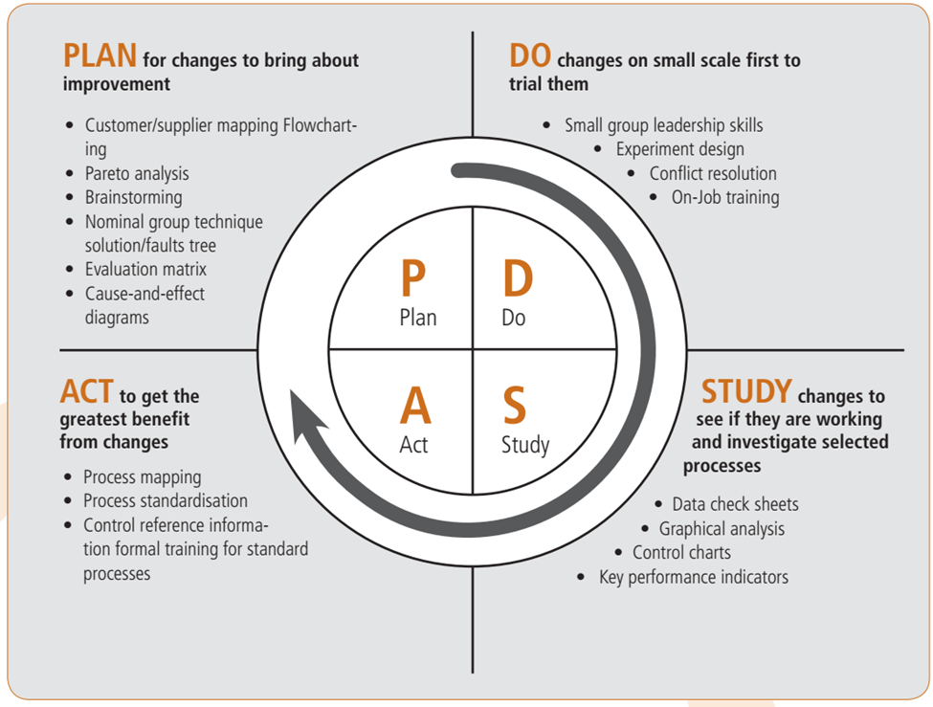
3) Quality improvement (QI) studies cont’d
Figure 5: Plan-Do-Study-Act cycle and research tools that can be used at each stage (Source: Brassard M. The Memory Jogger II: A Pocket Guide of Tools for Continuous Improvement and Effective Planning. Vol. First Edition. 1994, Methuen, MA: Goal/QPC.)

Slide 40
4) Participatory action research (PAR)
Although all research on human subjects involves human participation, PAR assigns power and control over the research process to the subjects themselves:
Thus, PAR refers to a range of research methods that typically involve iterative processes of reflection and action “carried out with and by local people rather than on them”
PAR implements a kind of “bottom-up” approaches that involve locally defined priorities and perspectives as described in Table 2 (next slides)
Although most of the PAR methods involve qualitative techniques, increasingly quantitative and mixed methods techniques are being used, as, for example, in participatory rural appraisal (PRA) or participatory statistics

Slide 41
4) Participatory action research (PAR) cont’d
Table 2: A comparison of participatory action research and conventional research (Source: Cornwall A, Jewkes R. What is participatory research? Soc Sci Med. 1995 Dec;41(12):1667-76.)
 | PAR | Conventional Research
What is the research for? | Action | Understanding with possible later action
Who is the research for? | Local people | Institutional, personal, and professional interests
Whose knowledge counts the most? | Local people’s | Scientist’s
Who chooses the topic? | Local priorities | Funding agency, institutional agendas, professional interests
Methodology is chosen for what reasons? | Empowerment and learning | Disciplinary convention, “objectivity”, “truth

Slide 42
4) Participatory action research (PAR) cont’d
Table 2: A comparison of participatory action research and conventional research…
 | PAR | Conventional Research
Who takes part in the stages of research?
Problem identification | Local people | Researcher
Data collection | Local people | Researcher, data collector
Interpretation | Local concepts and frameworks | Disciplinary theories and frameworks
Analysis | Local people | Researcher
Presentation of findings | Locally accessible and useful | By researcher to academics and funding agency
Action on findings | Integral to process | Usually separate or may not happen
Who takes action? | Local people, with or without external support | External agencies
Who owns the results? | Shared | The researcher or funder
Emphasis of process or outcomes? | Process | Outcomes

Slide 43
4) Participatory action research (PAR) cont’d
PAR example: the Indian NGO, Ekjut, which helps women’s groups to improve maternal and neonatal health in tribal areas of the Indian: (Source: Roy SS, Mahapatra R, Rath S, Bajpai A, Singh V, Rath S, Nair N, Tripathy P, Gope RK, Sinha R, Costello A, Pagel C, Prost A. Improved neonatal survival after participatory learning and action with women's groups: a prospective study in rural eastern India. Bull World Health Organ. 2013 Jun 1;91(6):426-433B.)
The success and sustainability of community-based programs for improving maternal and neonatal health require the active involvement of women, families and community health-care workers, yet the strategies used to engage these groups are often externally driven and top-down in character. Since 2005, the Indian NGO known as Ekjut has sought to reverse this trend by helping women’s groups to improve maternal and neonatal health in tribal areas of the Indian states of Jharkhand and Odisha.
Local female facilitators guide women’s groups through a cycle of activities involving participatory learning and action, during which women identify, prioritize and analyze local maternal and neonatal health problems and subsequently devise and implement strategies to address them. The Ekjut intervention was initially evaluated in a cluster randomized controlled trial carried out between 2005 and 2008 in 36 largely tribal clusters of three contiguous districts of Jharkhand and Odisha. A recent study reported significant falls in neonatal mortality in those districts as a result of the interventions and concluded that community mobilization through women’s groups can produce a sustainable and reproducible improvement in neonatal survival in rural areas of India.

Slide 44
5) Realist review
Provides explanatory analysis focused on what works for whom, in what circumstances, in what respects, and how
The aim is to enable decision-makers to reach a deeper understanding of the intervention and how its potential can be maximized in different settings
It is an iterative process that involves sharpening the focus of questions around the nature of the intervention by assessing the integrity of the underlying theory, comparing rival theories, and assessing the same theory in different settings:
Then it seeks empirical evidence in the literature that supports, contradicts or modifies the underlying program assumptions, combining theoretical understanding and empirical evidence, while focusing on the relationship between the context in which the intervention is applied
Example of realist review: Dieleman M, Kane S, Zwanikken P, Gerretsen B. Realist Review and Synthesis of Retention Studies for Health Workers in Rural and Remote Areas. World Health Organization; 2011. https://iris.who.int/handle/10665/44548

Slide 45
6) Mixed methods researches
Uses both qualitative and quantitative methods of data collection and analysis in the same study
While not designed specifically for IR, mixed-methods research is particularly suitable for these research activities because:
It provides a practical way to understand multiple perspectives, different types of causal pathways, and multiple types of outcomes – all of which are common in implementation settings

Slide 46
6) Mixed methods researches cont’d
Mixed methods research schemes:
Many different schemes exist for describing different types of mixed methods research:
On the basis of the emphasis of the study,
The sampling schemes for the different components,
The timing and sequencing of the qualitative and quantitative methods, and
The level of mixing between the qualitative and quantitative methods.

Slide 47
6) Mixed methods researches cont’d
Uses and applications of mixed methods research
Mixed methods are extremely useful and applicable for a range of purposes, these can be boiled down to 4 main rationales:
Participant enrichment: to gain the most information from a sample of participants (e.g. by administering a standard survey questionnaire and then asking for in-depth explanations)
Instrument validity: to make sure that the instruments used are appropriate and useful (e.g. using FGD to identify items for a questionnaire or testing its validity)
Implementation fidelity (treatment integrity): to assess whether the intervention or program is being administered as intended
Meaning enhancement: to maximize the interpretation of the findings, such as by using qualitative measures to explain the statistical analysis or vice versa

Slide 48
6) Mixed methods researches cont’d
How to report a mixed method study design?
Broad guidance on the design, conduct, and reporting of mixed-methods designs are available by several authors. A simple scheme for good reporting of a mixed-methods study (GRAMMS) involves:
Describing the justification for using a mixed methods approach to address the research question
Describing the design in terms of the purpose, priority and sequence of methods
Describing each method in terms of sampling, data collection and analysis
Describing where the integration has occurred, how it has occurred, and who has participated in it
Describing any limitation derived from associating one method with another method
Describing any insights gained from mixing or integrating methods.

Slide 49
Importance of the research question in IR
In IR, the “question is king”, and it is the question that determines the method used, rather than the method that determines the kind of questions asked
The questions asked are often complex, reflecting the complexity of the real world:
A wide array of contextual factors influence implementation, producing unpredictable effects that require continuous adaptation by implementers
Given the importance of the research question, it is quite useful to consider the kinds of questions that are likely to arise, and the research methods that may be appropriate to answering them:
One way of going about this is to break down research questions into a limited number of categories based on the core objective of the research to be undertaken: Table 3 (next few slides)

Slide 50
Importance of the research question in IR cont’d
Table 3: Type of implementation research objective, implementation question, and research methods
(Adapted from: Habicht et al., 1999, Peters et al., 2009)
Objective | Description | Implementation Question | Research methods and data collection approaches
Explore | Explore an idea or phenomenon to make hypotheses or generalizations from specific examples | What are the possible factors and agents responsible for good implementation of a health intervention? For enhancing or expanding a health intervention? | Qualitative methods: Grounded theory, ethnography, phenomenology, case-studies and narrative approaches; key informant interviews, FGDs, historical reviews Quantitative: Network analysis, Cross-sectional surveys Mixed: Combining qualitative and quantitative
Describe | Identify and describe the phenomenon and its correlates or possible causes | What describes the context in which implementation occurs? What describes the main factors influencing implementation in a given context? | Quantitative: Cross-sectional (descriptive) surveys, network analysis Qualitative: Grounded theory, ethnography, phenomenology, case-studies and narrative approaches; key informant interviews, FGDs, historical reviews Mixed: Both qualitative and quantitative inquiry with convergence of data and analyses

Slide 51
Importance of the research question in IR cont’d
Table 3: Type of implementation research objective, implementation question, and research methods…
Objective | Description | Implementation Question | Research methods and data collection approaches
Influence: Test whether an intervention produces an expected outcome
With Adequacy | With sufficient confidence that the intervention and outcomes are occurring | Is coverage of a health intervention changing among beneficiaries of the intervention? | Before-after or time-series in intervention recipients only; Participatory action research
With Plausibility | With greater confidence that the outcome is due to the intervention | Is a health outcome plausibly due to the implemented intervention rather than other causes? | Concurrent, non-randomized cluster trials: health intervention implemented in some areas and not in others; before-after or cross-sectional study in program recipients and non-recipients; Typical quality improvement studies
With Probability | With a high (calculated) probability that the outcome is due to the intervention | Is a health outcome due to implementation of the intervention? | Partially controlled trials: Pragmatic and cluster randomized trials; Health intervention implemented in some areas and not in others; Effectiveness-Implementation Hybrids

Slide 52
Importance of the research question in IR cont’d
Table 3: Type of implementation research objective, implementation question, and research methods…
Objective | Description | Implementation Question | Research methods and data collection approaches
Explain | Develop or expand a theory to explain the relationship between concepts and the reasons for the occurrence of events, and how they occurred? | How and why does implementation of the intervention lead to effects on health behavior, services or status in all its variations? | Mixed methods: Both qualitative and quantitative inquiry with convergence of data and analyses Quantitative: Repeated measures of context, actors, depth and breadth of implementation across subunits; network identification; can use designs for confirmatory inferences; Effectiveness implementation hybrids; Qualitative methods: Case-studies, phenomenological and ethno graphic approaches with key informant interviews, focus groups, historical reviews Participatory action research
Predict | Use prior knowledge or theories to forecast future events | What is the likely course of future implementation? | Quantitative: Agent-based modeling; Simulation and forecasting modeling; Data extrapolation and sensitivity analysis (trend analysis, econometric modeling) Qualitative: Scenario building exercises; Delphi techniques from opinion leaders

Slide 53
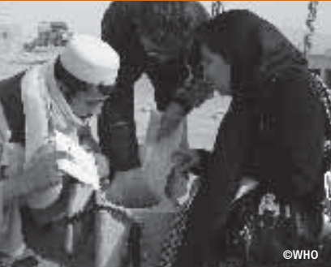
How should implementation research be conducted?
IR should be aligned with need, both in the sense that it meets the requirements of the intended audience and is also responsive to the particularities of the subject under study-
Be responsive to the demands of your subject and your audience
Importance of flexible and responsive IR:
Both health systems and its actors are constantly changing and adapting to new actions, often reacting in unpredictable ways
Contextual factors can influence implementation and these factors can also change over time, producing unpredictable effects that require continuous adaptation by implementers:
Research designs need to be responsive and capable of capturing these changing elements at multiple points in time

Slide 54
How should implementation research be conducted? cont’d
Good IR should be able to address each of the following questions:
Will the research answer a relevant and important implementation problem?
Is the new knowledge potentially worth the cost of the research?
Are there clear research objectives and questions related to implementation, and does the proposed research design match them? (see Table 3)
Does the research fit with a theory of change or causal chain in a coherent way? If not, what is the potential for generating new theories or questions?
Will the research produce results that can be acted on in a timely way by the intended audiences?
Does the research design reflect an understanding about whether the intervention is stable and simply replicable, or whether the intervention is expected to change?
Does the research adequately capture changes that occur over time and place in both the intervention, the context, and the effects?
In complex environments, can the research identify the main components of the health system and their relationships, as well as the unintended consequences that are likely to occur from an intervention?

Slide 55
Key questions to assess quality of research designs or reports on IR
Does the research clearly aim to answer a question concerning implementation?
Does the research clearly identify the primary audiences for the research and how they would use the research?
Is there a clear description of what is being implemented (for example, details of the practice, program, or policy)?
Does the research involve an implementation strategy? If so, is it described and examined in its fullness?
Is the research conducted in a “real world” setting? If so, is the context and sample population described in sufficient detail?
Does the research appropriately consider implementation outcome variables?
Does the research appropriately consider context and other factors that influence implementation?
Does the research appropriately consider changes over time, and the level of complexity of the system?

Slide 56
How can the potential of implementation research be realized?
Despite the importance of IR, it continues to be a neglected field of study for 2 reasons:
Lack of understanding regarding what it is and what it has to offer and
Lack of funding for IR activities
Without IR we are at best committing valuable resources to implementation in the hope that things will work out:
IR is not on the whole an expensive pursuit so investments in it go a long way
We now have many of the interventions and technologies needed to reduce morbidity and mortality, and should focus more on making better use of them
More opportunities for researchers and implementers in LMICs who want to undertake IR are needed

Slide 57
How can the potential of implementation research be realized? cont’d
Agenda for actions to support and promote IR:
Action #1: IR should be seen as a core part of program implementation.
Embedding research into the program cycle in an iterative progression that allows for continuous learning and, where necessary, adaptation
Bottom line: implementers need to take a more active role in IR
Action #2: To ensure that IR becomes more accessible, researchers should be encouraged to engage in program activities
Action #3: Implementers need to make programs more accessible to researchers and invite researchers to participate in programs
Action #4: Make more funding available for IR and align this funding with funding for programs:
Funding for IR be made available within program budgets or explicitly tied to program activities

Slide 58
How can the potential of implementation research be realized? cont’d
Agenda for actions to support and promote IR…
Action #5: More training opportunities for IR need to be made available to program personnel or implementers:
IR should also be built into training programs such as MPH
Action #6: Provide more guidance and opportunities for mentorship to researchers and implementers in LMICs who want to undertake IR
Action #7: Incentives for researchers should be linked to engaging in making changes in policies and programs, in addition to incentives related to academic publication and teaching

Slide 59
Example of implementation research 1
Mitchell SG, Schwartz RP, Kirk AS, Dusek K, Oros M, Hosler C, Gryczynski J, Barbosa C, Dunlap L, Lounsbury D, O'Grady KE, Brown BS. SBIRT Implementation for Adolescents in Urban Federally Qualified Health Centers. J Subst Abuse Treat. 2016 Jan;60:81-90. doi: 10.1016/j.jsat.2015.06.011. Epub 2015 Jun 26. PMID: 26297321; PMCID: PMC4548813.

Slide 60
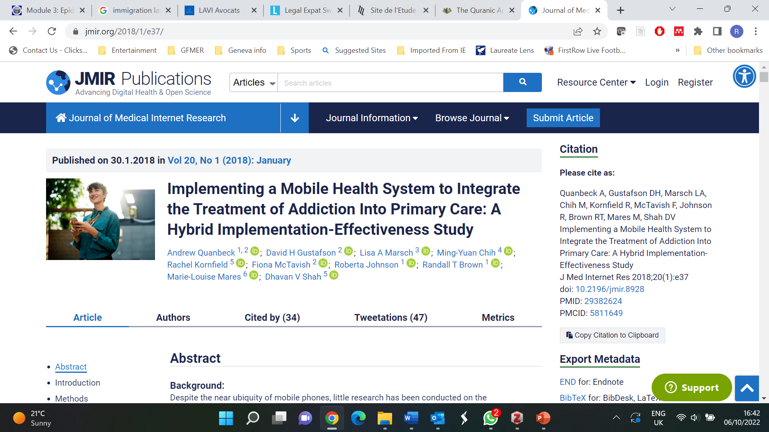
Example of implementation research 2
Quanbeck A, Gustafson DH, Marsch LA, Chih M-Y, Kornfield R, McTavish F, Johnson R, Brown RT, Mares M-L, Shah DV. Implementing a Mobile Health System to Integrate the Treatment of Addiction Into Primary Care: A Hybrid Implementation-Effectiveness Study. Journal of Medical Internet Research. 2018 Jan 30;20(1):e8928. http://dx.doi.org/10.2196/jmir.8928

Slide 61
References
Brassard M. The Memory Jogger II: A Pocket Guide of Tools for Continuous Improvement and Effective Planning. Vol. First Edition. 1994, Methuen, MA: Goal/QPC. https://www.amazon.com/Memory-Jogger-Continuous-Improvement-Effective/dp/1879364441
Center for Health Policy and Management Faculty of Medicine, UGM. IR for UHC National Dissemination Workshop JS Luwansa, 19 December 2017. https://slideplayer.com/slide/14535022/
Cornwall A, Jewkes R. What is participatory research? Soc Sci Med. 1995 Dec;41(12):1667-76. https://doi.org/10.1016/0277-9536(95)00127-s
Fairall L, Bachmann MO, Lombard C, Timmerman V, Uebel K, Zwarenstein M, Boulle A, Georgeu D, Colvin CJ, Lewin S, Faris G, Cornick R, Draper B, Tshabalala M, Kotze E, van Vuuren C, Steyn D, Chapman R, Bateman E. Task shifting of antiretroviral treatment from doctors to primary-care nurses in South Africa (STRETCH): a pragmatic, parallel, cluster-randomised trial. Lancet. 2012 Sep 8;380(9845):889-98. https://doi.org/10.1016/s0140-6736(12)60730-2
Habicht JP, Victora CG, Vaughan JP. Evaluation designs for adequacy, plausibility and probability of public health programme performance and impact. Int J Epidemiol. 1999 Feb;28(1):10-8. https://doi.org/10.1093/ije/28.1.10
Mandala J, Torpey K, Kasonde P, Kabaso M, Dirks R, Suzuki C, Thompson C, Sangiwa G, Mukadi YD. Prevention of mother-to-child transmission of HIV in Zambia: implementing efficacious ARV regimens in primary health centers. BMC Public Health. 2009 Aug 27;9:314. https://doi.org/10.1186/1471-2458-9-314

Slide 62
References
Peters DH, editor. Improving health service delivery in developing countries: from evidence to action. World Bank Publications; 2009. https://openknowledge.worldbank.org/handle/10986/12335
Peters DH, Tran N, Adam T, Ghaffar A. Implementation research in health: a practical guide. Alliance for Health Policy and Systems Research, World Health Organization; 2013. https://apps.who.int/iris/bitstream/handle/10665/91758/9789241506212_eng.pdf
Remme JH, Adam T, Becerra-Posada F, D'Arcangues C, Devlin M, Gardner C, Ghaffar A, Hombach J, Kengeya JF, Mbewu A, Mbizvo MT, Mirza Z, Pang T, Ridley RG, Zicker F, Terry RF. Defining research to improve health systems. PLoS Med. 2010 Nov 16;7(11):e1001000. https://doi.org/10.1371/journal.pmed.1001000
Roy SS, Mahapatra R, Rath S, Bajpai A, Singh V, Rath S, Nair N, Tripathy P, Gope RK, Sinha R, Costello A, Pagel C, Prost A. Improved neonatal survival after participatory learning and action with women's groups: a prospective study in rural eastern India. Bull World Health Organ. 2013 Jun 1;91(6):426-433B. https://doi.org/10.2471/blt.12.105171
World Health Organization and ExpandNET. Nine steps for developing a scaling up strategy. World Health Organization; 2010. https://iris.who.int/handle/10665/44432
World Health Organization & UNICEF/UNDP/World Bank/WHO Special Programme for Research and Training in Tropical Diseases‎. Implementation research toolkit. World Health Organization; 2014. https://iris.who.int/handle/10665/110523

Slide 63
Further reading materials and useful links
Baqui AH, El-Arifeen S, Darmstadt GL, Ahmed S, Williams EK, Seraji HR, Mannan I, Rahman SM, Shah R, Saha SK, Syed U, Winch PJ, Lefevre A, Santosham M, Black RE; Projahnmo Study Group. Effect of community-based newborn-care intervention package implemented through two service-delivery strategies in Sylhet district, Bangladesh: a cluster-randomised controlled trial. Lancet. 2008 Jun 7;371(9628):1936-44. https://doi.org/10.1016/s0140-6736(08)60835-1
Baqui AH, Arifeen SE, Rosen HE, Mannan I, Rahman SM, Al-Mahmud AB, Hossain D, Das MK, Begum N, Ahmed S, Santosham M, Black RE, Darmstadt GL; Projahnmo Study Group. Community-based validation of assessment of newborn illnesses by trained community health workers in Sylhet district of Bangladesh. Trop Med Int Health. 2009 Dec;14(12):1448-56. https://doi.org/10.1111/j.1365-3156.2009.02397.x
Brownson RC, Colditz GA, Proctor EK, editors. Dissemination and implementation research in health: translating science to practice. Oxford University Press; 2017. https://academic.oup.com/book/26456
Choi Y, El Arifeen S, Mannan I, Rahman SM, Bari S, Darmstadt GL, Black RE, Baqui AH; Projahnmo Study Group. Can mothers recognize neonatal illness correctly? Comparison of maternal report and assessment by community health workers in rural Bangladesh. Trop Med Int Health. 2010 Jun;15(6):743-53. https://doi.org/10.1111/j.1365-3156.2010.02532.x
Curran GM, Bauer M, Mittman B, Pyne JM, Stetler C. Effectiveness-implementation hybrid designs: combining elements of clinical effectiveness and implementation research to enhance public health impact. Med Care. 2012 Mar;50(3):217-26. https://doi.org/10.1097/mlr.0b013e3182408812
Davidoff F, Batalden P, Stevens D, Ogrinc G, Mooney S; SQUIRE Development Group. Publication guidelines for quality improvement in health care: evolution of the SQUIRE project. Qual Saf Health Care. 2008 Oct;17 Suppl 1(Suppl_1):i3-9. https://doi.org/10.1136/qshc.2008.029066

Slide 64
Further reading materials and useful links
Dieleman M, Kane S, Zwanikken P, Gerretsen B. Realist Review and Synthesis of Retention Studies for Health Workers in Rural and Remote Areas. World Health Organization; 2011. https://iris.who.int/handle/10665/44548
Peters DH, Adam T, Alonge O, Agyepong IA, Tran N. Implementation research: what it is and how to do it. BMJ. 2013 Nov 20;347:f6753. https://doi.org/10.1136/bmj.f6753
Proctor E, Silmere H, Raghavan R, Hovmand P, Aarons G, Bunger A, Griffey R, Hensley M. Outcomes for implementation research: conceptual distinctions, measurement challenges, and research agenda. Adm Policy Ment Health. 2011 Mar;38(2):65-76. https://doi.org/10.1007/s10488-010-0319-7
Sanders D, Haines A. Implementation research is needed to achieve international health goals. PLoS Med. 2006 Jun;3(6):e186. https://doi.org/10.1371/journal.pmed.0030186
Shah R, Munos MK, Winch PJ, Mullany LC, Mannan I, Rahman SM, Rahman R, Hossain D, El Arifeen S, Baqui AH. Community-based health workers achieve high coverage in neonatal intervention trials: a case study from Sylhet, Bangladesh. J Health Popul Nutr. 2010 Dec;28(6):610-8. https://doi.org/10.3329/jhpn.v28i6.6610

