Slide 1
SAFE ABORTION CARE
Geneva 2022
Dr Venkatraman Chandra-Mouli

Slide 2
DEFINITIONS
Induced abortion: Intentional loss of an intrauterine pregnancy due to medical or surgical means.
Safe abortion: Abortion that meets all three criteria (i) is done with a method recommended by WHO (medical abortion, vacuum aspiration, dilatation & evaluation) (ii) is appropriate to the pregnancy duration (iii) is provided by/supported by a trained health-care provider.
Less safe abortion: Abortion that (i) is done by a trained health-care provider, but with an outdated method e.g. sharp curettage (ii) is done using a WHO recommended method but without information and support from a trained individual.
Least safe abortion: Abortion provided by untrained individuals using dangerous methods e.g. ingestion of caustic substances.
Notes:
This slide provides some key definitions.

Slide 3
RATIONALE -1/2
Unsafe abortion is an important problem: An estimated 5.7 million girls aged 15-19 years undergo abortions every year in LMICs, the majority of which are unsafe.¹
Unsafe abortions in adolescents have major health consequences: Compared to older women, adolescents are more likely to seek abortions from untrained providers, to have a self-induced abortion, to terminate pregnancies after their first trimester, to delay seeking medical care for complications following unsafe abortions.² They are also less likely to know about their rights concerning abortion and post-abortion care, & to report having had an abortion.²
Notes:
References:
Guttmacher Institute. Fact sheet: Adding it up: Investing in adolescents’ sexual and reproductive health in low- and middle-income countries. New York: Guttmacher Institute; 2019.
Guttmacher Institute. Adolescents’ need for and use of abortion services in developing countries. New York: Guttmacher Institute; 2016.

Slide 4
RATIONALE -2/2
Safe abortion carries low health risks: While the risks differ depending on the duration of the pregnancy, the method used, and the people carrying out the method, safe abortion can have a lower risk than an injection of penicillin or carrying a pregnancy to term.
Abortion related-laws & policies, the provision of good quality services need attention: Access to safe abortion services is highly restricted in many countries despite evidence that restrictive abortion laws are associated with higher levels of maternal mortality. When safe abortion is legally allowed for adolescents, it is often not adolescent friendly.
Notes:
This is the second of two slides that provide the rationale for investment in this area.

Slide 5
HUMAN RIGHTS OBLIGATIONS
States are obliged under human rights law to provide safe abortion care.
Implementation of measures to prevent unsafe abortion & to provide post-abortion care are part of the core obligation of states to uphold the right to sexual & reproductive health.
States are obliged to ensure universal access to a comprehensive package of sexual & reproductive health interventions including safe abortion care & post-abortion care (the latter whether or not abortion is legal).
Human rights mechanisms have called for the decriminalization of abortion & removal of barriers such as third-party consent requirements.
Denial of abortion and forced continuation of pregnancy have been identified as a form of gender-based violence.
Notes:
This slide sets out the human rights obligations of states in relation to providing safe abortion care.

Slide 6
KEY CONCEPTS TO CONSIDER
Restrictive laws & policies often force adolescents to seek illegal & unsafe abortions: Laws & policies should promote the respect & protection of women & girls. This includes ensuring timely access to safe abortion & addressing stigma & discrimination against those who seek abortion services or post-abortion care.
Adolescents are less likely than adult women to obtain safe abortion services: Adolescents & other stakeholders should be informed about the dangers of unsafe abortions, the safe abortion services available, & the circumstances in which they can be legally obtained.
Abortion services & health care providers are often not adolescent friendly: Health care providers must be trained & supported to inform, counsel & provide services to adolescents according to their evolving capacities, & to be responsive to the needs of different groups of adolescents.

Slide 7
WHO GUIDELINES
Medical management of abortion (2018).
Safe abortion: technical & policy guidance for health systems (2012).
WHO guidelines on preventing early pregnancy and poor reproductive outcomes among adolescents in developing countries (2011).
Policy- ensure laws & policies enable adolescents to obtain safe abortion services;
Community- identify & overcome barriers for the provision on safe abortion services;
Health facility- ensure adolescents have access to post-abortion care regardless of whether the abortion or attempted abortion was legal;
Individual- inform adolescents & other stakeholders about the dangers of unsafe methods of interrupting a pregnancy, safe abortion services legally available & under what circumstances they can be obtained.
Health worker roles in providing safe abortion care and post-abortion contraception (2015).
Ensuring human rights in the provision of contraceptive information and services: Guidance and recommendations (2014).
Consolidated guideline on sexual and reproductive health and rights of women living in HIV (2017).

Slide 8
COMPLEMENTARY DOCUMENTS TO WHO’s GUIDELINES
Clinical practice handbook for safe abortion, WHO, 2014.
Interagency statement: preventing gender-biased sex selection, WHO, 2011.
Sexual health, human rights and the law, WHO, 2015.
Sexual health and its linkages to reproductive health: an operational approach, WHO, 2017.
Renner R-M, de Guzman A, Brahmi D. Abortion care for adolescent and young women. Int J Gynecol Obstet. 2014;126(1):1–7.
Adolescents’ need for and use of abortion services in developing countries. New York: Guttmacher Institute; 2016.
Provision of abortion care for adolescent and young women: a systematic review. Chapel Hill, NC: Ipas; 2013.

Slide 9
Specific measures for delivery of services in the context of COVID-19 – 1/2
Inform adolescents where and how to access comprehensive abortion care, including safe abortion to the full extent of the law and post-abortion care, through appropriate channels.
In health facilities, ensure that comprehensive abortion care remains available for adolescents, is safe and is provided respectfully and confidentially.
Consider relaxing policies to enable the use of telemedicine for the provision of medical abortion to adolescents to avoid unnecessary clinical visits.
Consider reducing barriers that delay access to care and therefore increase risks of adolescents reverting to un-safe abortion practices. In particular, consider waiving restrictions (if these exist), such as on age, parental/spousal consent or marital status, and providing services subsidized or free of charge within the relevant legal framework and inline with international guidelines.

Slide 10
Specific measures for delivery of services in the context of COVID-19 – 2/2
Ensure that gender-based violence prevention and treatment services are available to the adolescent during the care encounter, or that the adolescent is referred based on their individual situation.
Ensure that sexually transmitted infection (STI) services are available to the adolescent during the care encounter, or that the adolescent is referred based on their individual situation.
Counsel adolescents on, and provide, post-abortion contraception, where desired, to avoid rapid repeat pregnancy.

Slide 11
Considerations for resumption of normal services in the context of COVID-19
Where possible, promote the institutionalization of good practices in improving accessibility and quality that were put in place during the period of closures and disruption.

Slide 12
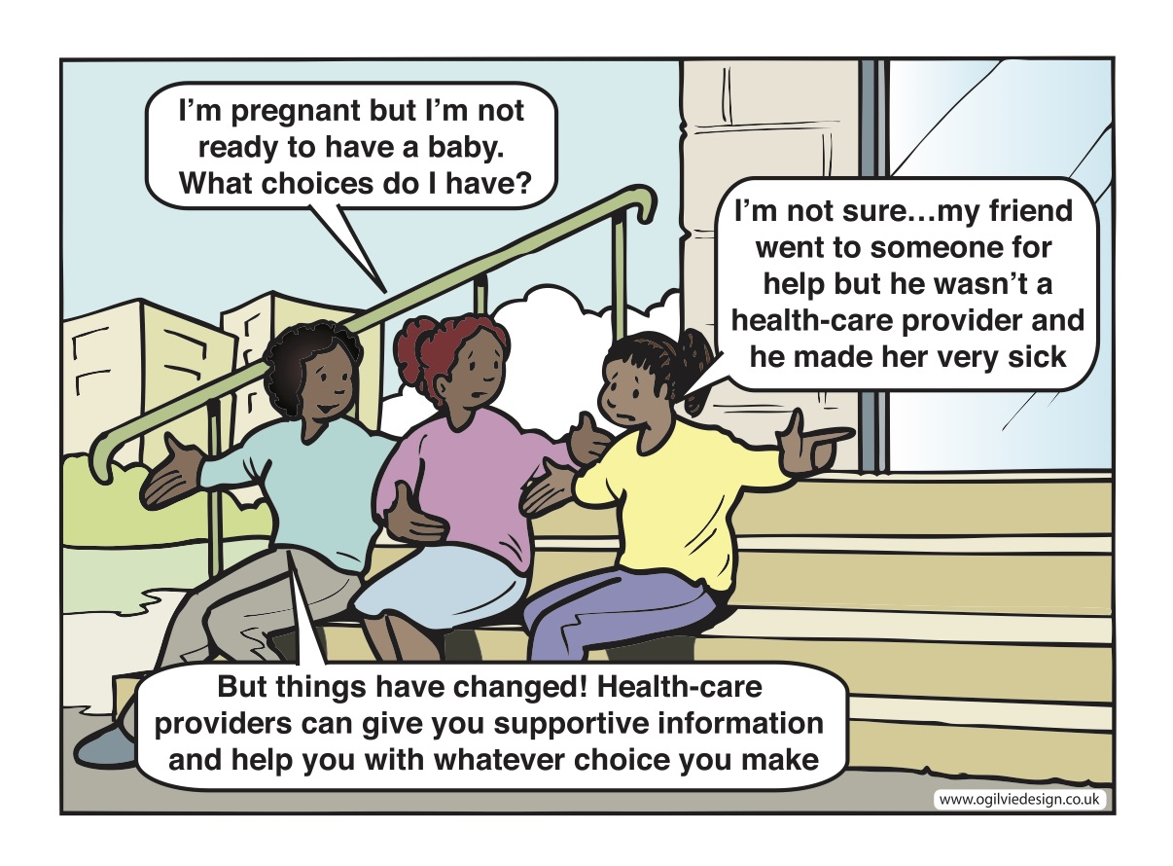

Slide 13
SAFE ABORTION CARE
A Regional Perspective
Access to legal, safe and comprehensive abortion care, including post-abortion care, is essential for the attainment of the highest possible level of sexual and reproductive health. (WHO, c2022)
Notes:
Reference:
WHO. Abortion. World Health Organization; c2022: Available from: https://www.who.int/health-topics/abortion#tab=tab_1

Slide 14
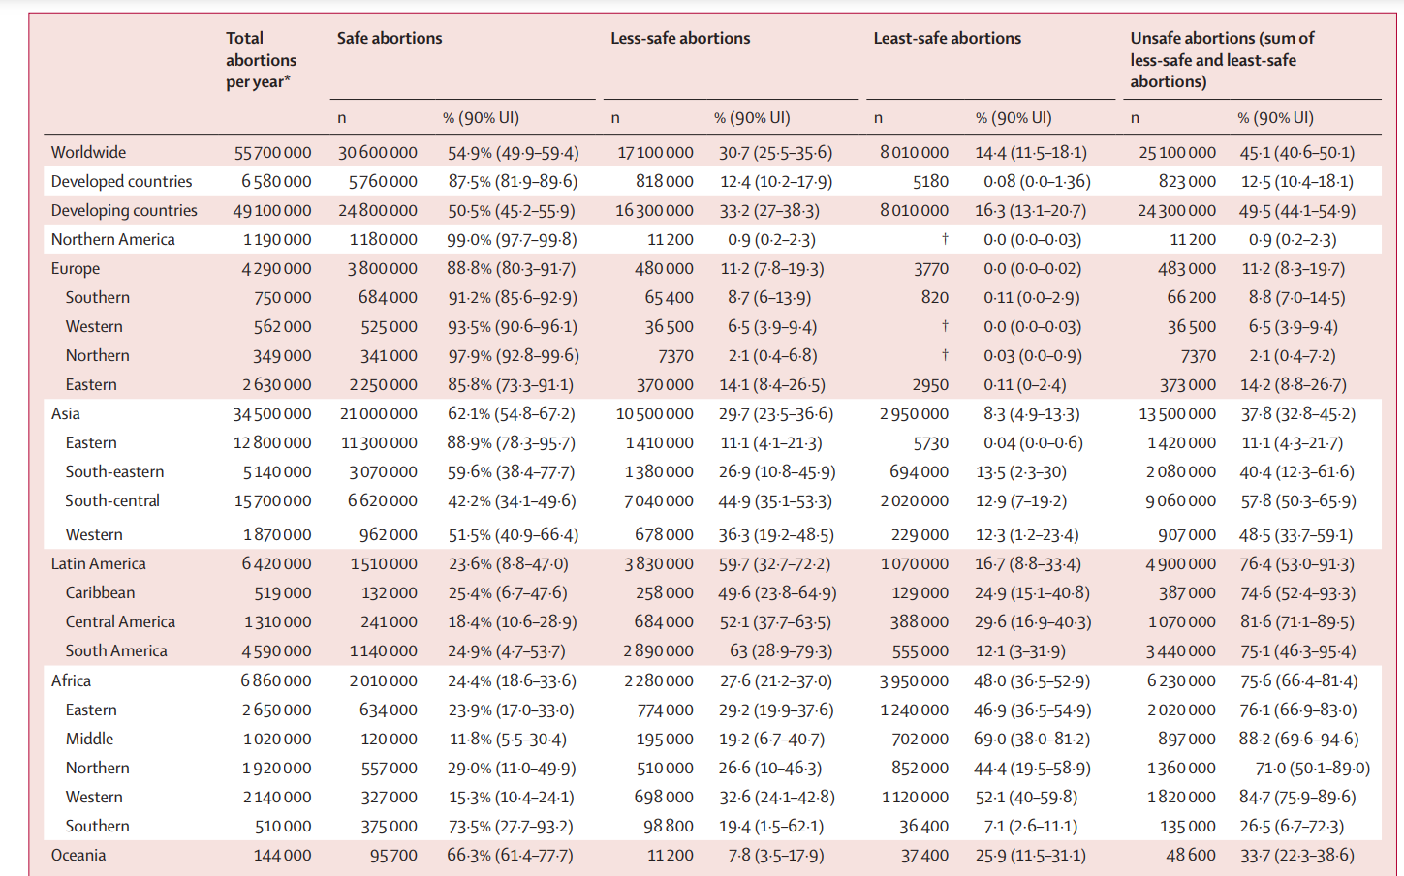
Number of abortion cases in the EMR
Modelled estimates
Western Asia:
1,870,000 abortions per year
Of which, 51.5% are safe, and 48.5% are unsafe
Northern Africa:
1,920,000 abortions per year
Of which, 29% are safe and 71% are unsafe.
Source: Ganatra et al., 2017.
Notes:
WHO regional classifications were not used. Instead, World Bank groups were used. The closes to EMR estimates are represented by Western Asia and Northern Africa
Northern Africa included the following countries: Algeria, Egypt, Libya, Morocco, Sudan and Tunisia
Western Asia included Armenia, Azerbaijan, Bahrain, Cyprus, Georgia, Iraq, Israel, Jordan, Kuwait, Lebanon, Oman, Qatar, Saudi Arabia, State of Palestine, Syrian Arab Republic, Turkey and United Arab Emirates
Reference:
Ganatra B, Gerdts C, Rossier C, Johnson BR, Tunçalp Ö, Assifi A, Sedgh G, Singh S, Bankole A, Popinchalk A, Bearak J, Kang Z, Alkema L. Global, regional, and subregional classification of abortions by safety, 2010–14: estimates from a Bayesian hierarchical model. The Lancet. 2017 Nov 25;390(10110):2372-81. http://dx.doi.org/10.1016/S0140-6736(17)31794-4

Slide 15
Laws and policies on abortion
Current situation
Most countries of the EMR have restrictive laws/policies on abortion. However, some countries have certain provisions related to abortion. The regional Reproductive, Maternal, Newborn, Child, and Adolescent Health Policy Survey 2019 provide some information on Abortion Policies in the member states (1):
11 out of 16 countries include abortion as a component of their Reproductive Healthcare National Policy.
15 out of 16 countries include vacuum aspiration as supplies and equipment indicated for use in pregnancy, childbirth and postpartum care in their National Commodities List.
6 countries (Afghanistan, Bahrain, Egypt, Oman, Morocco, and Pakistan) include contraception in post-abortion care (2).
Notes:
References:
The regional reproductive, maternal, newborn, child, and adolescent health policy survey 2019. (unpublished data)
WHO. Global Abortion Policies Database: Identified Policy and Legal Sources Related to Abortion: World Health Organization; c2017. Available from: https://abortion-policies.srhr.org/

Slide 16
EMR countries have most restrictive abortion laws
Source: Center for Reproductive Rights. The World’s Abortion Laws. Center for Reproductive Rights; c 1992-2021.
Notes:
The World Abortion Laws Map is the definitive record of the legal status of abortion in countries across the globe. Since 1998, the Center for Reproductive Rights has produced this map as a resource for advocates, government officials, and civil society organizations working to advance abortion rights as human rights for women and girls* around the globe. The map categorizes the legal status of abortion on a continuum from severe restrictiveness to relative liberality. It is updated in real time, reflecting changes in national laws so human rights advocates can monitor how countries are protecting—or denying—reproductive rights around the world.
Reference:
Center for Reproductive Rights. The World’s Abortion Laws. Center for Reproductive Rights; c 1992-2021. Available from: https://reproductiverights.org/worldabortionlaws

Slide 17
Laws and policies on abortion
All Arab countries require authorization from one or more doctors for abortion to be performed. Spousal consent is required in Kuwait, Morocco, Qatar, Saudi Arabia, Syria, the United Arab Emirates, and Yemen.
In 1965, Tunisia became the first Arab country to legalize abortion as part of an effort to end unsafe abortion and improve women’s health.
Illustrative laws from the region:
Articles 321–325 of the Palestinian Criminal Code (Law 16/1960) criminalize the woman and any person who assists her.
Sudan’s Criminal Code of 1991 stipulates punishments for illegal abortion. If the pregnancy is of less than 90 days’ duration, the person who performs the abortion is subject to up to three years in prison and/or payment of a fine. If the duration of the pregnancy is of more than 90 days, the penalty for performing an abortion increases to up to five years’ imprisonment
Source: UNFPA. Addressing unintended pregnancy in the Arab region. UNFPA; 2018.
Notes:
Reference:
UNFPA. Addressing unintended pregnancy in the Arab region. UNFPA; 2018. Available from: https://arabstates.unfpa.org/sites/default/files/pub-pdf/addressing_unintended_pregnancy_in_the_as_report.pdf

Slide 18
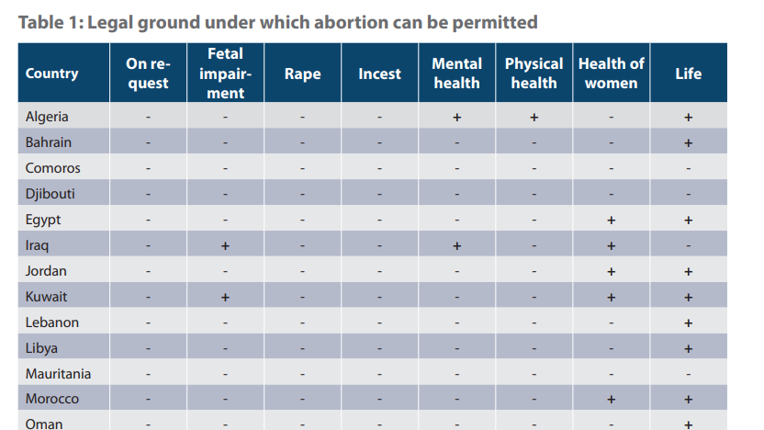
Source: UNFPA. Addressing unintended pregnancy in the Arab region. UNFPA; 2018.
Notes:
Reference:
UNFPA. Addressing unintended pregnancy in the Arab region. UNFPA; 2018. Available from: https://arabstates.unfpa.org/sites/default/files/pub-pdf/addressing_unintended_pregnancy_in_the_as_report.pdf

Slide 19
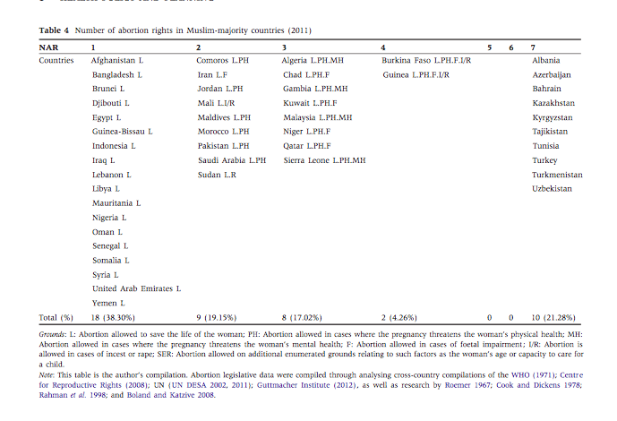
Muslim-Majority Countries Position on Abortion by Number of Abortion Rights‬ (NAR) Based on Seven Dimensions in a Country (‭Ramirez and McEneaney, 1997)
*Please see notes for the seven dimensions of abortion rights
Notes:
One method to compare Muslim-majority countries position on abortion is by examining the ‭Number of Abortion Rights‬ (hereafter NAR) in a country. In accordance with the United Nations and similar to ‭Ramirez and McEneaney (1997), the study considers seven dimensions to calculate NAR. These include:
1. Abortion is permitted to save the life of the pregnant woman (L)
2. Abortion is permitted to preserve a woman’s physical health (PH)
3. Abortion is permitted to preserve a woman’s mental health (MH)
4. Abortion is permitted in cases of foetal impairment (F)
5. Abortion is permitted in cases of incest or rape (I/R)‬
6. Abortion is permitted for social or economic reasons (SER)‬
7. Abortion is permitted upon request
Table 4 exemplifies that many Muslim-majority countries are‬ currently conservative in their abortion policy. Specifically, 18 of 47 Muslim-majority countries only permit abortions in cases‬ where the life of the pregnant women is threatened (Table 4).‬ However, notably, all Muslim countries allow abortions to save woman’s life, i.e., in no country is there a zero count.
Reference:
Ramirez FO, McEneaney EH. From women’s suffrage to reproduction rights? Cross-national considerations. Int J Comp Sociol. 1997 Jun;38(1-2):6-24.

Slide 20
Laws and policies on abortion
Implications of the current situation
According to an analysis by UN DESA (2014), reproductive outcomes in countries with restrictive laws/policies on abortion are worse compared to countries with liberal laws/policies.
Reproductive outcomes | Countries with restrictive laws/policies on abortion | Countries with liberal laws/policies on abortion
The average rate of unsafe abortion | 26.7/1000 women 15-49 | 6.1/1000 women
Rate of maternal death | 223 maternal deaths/100,000 live births | 77 maternal deaths/100,000 live births
Fertility rate in adolescents (15-19 years) | 69/1000 births | 24/1000 births
Notes:
Reference:
United Nations, Department of Economic and Social Affairs, Population Division. Abortion policies and reproductive health around the world. United Nations; 2014. (Sales No. E.14.XIII.11). Available from: https://www.un.org/en/development/desa/population/publications/policy/abortionPoliciesAndReproductiveHealth.asp

Slide 21
Barriers to adolescents’ access to safe abortion care in the region
Lack of data: Most countries in the region lack official statistics on abortion. This is especially true of official statistics on abortion among marginalized women (e.g., unmarried women, adolescent girls).
Barriers to accessing services: Lack of information, lack of infrastructure, cost, and fear of confidentiality breeches prevent adolescents, unmarried women/girls, and women/girls with unregistered marriages from accessing safe abortion services.
Legal/policy restrictions: Restrictive laws and policies on abortion prevent women, and especially adolescent girls, from accessing safe abortion and push some to seek unsafe abortion services (1,2). An Iranian study showed that one-third of 33% of abortions in studied population were performed by nonmedical providers (3).
Stigma associated with abortion: Across the EMR, there is a perception that improving access to safe abortion services will increase the abortion rate (4).
Notes:
References:
Ganatra B, Gerdts C, Rossier C, Johnson BR, Tunçalp Ö, Assifi A, Sedgh G, Singh S, Bankole A, Popinchalk A, Bearak J, Kang Z, Alkema L. Global, regional, and subregional classification of abortions by safety, 2010–14: estimates from a Bayesian hierarchical model. The Lancet. 2017 Nov 25;390(10110):2372-81. http://dx.doi.org/10.1016/S0140-6736(17)31794-4
Soussane SY. Abortion in Morocco: will the king approve a progressive law? the Guardian. 2015 May 5 [cited 2016 Jun 22]. Available from: http://www.theguardian.com/global-development-professionals-network/2015/may/05/abortion-in-morocco-will-the-king-approve-a-progressive-law.
Ranji A. Induced abortion in Iran: prevalence, reasons, and consequences. J Midwifery Womens Health. 2012 Oct;57(5):482-8. http://dx.doi.org/10.1111/j.1542-2011.2012.00159.x
Sharma AC, Dhillon J, Shabbir G, Lynam A. Notes from the field: political norm change for abortion in Pakistan. Sexual and Reproductive Health Matters. 2019 May 31;27(2):126-32. http://dx.doi.org/10.1080/26410397.2019.1586819

Slide 22
Barriers to adolescents’ access to safe abortion care in the region
Lack of political commitment: Politicians refrain from engaging in efforts to expand and modernize the provision of safe abortion care (1).
Choice and competency of service provider: Lack of availability of preferred service providers and lack of adolescent-friendliness of existing service providers discourage many girls from seeking safe abortion care. For example, an Iranian study showed that one-third of abortions in studied population were performed by a nonmedical providers (2).
Humanitarian settings: The political conflicts in various countries increase adolescents’ vulnerability to unplanned pregnancy and thus increase their possible need for abortion services.
Notes:
References:
Sharma AC, Dhillon J, Shabbir G, Lynam A. Notes from the field: political norm change for abortion in Pakistan. Sexual and Reproductive Health Matters. 2019 May 31;27(2):126-32. http://dx.doi.org/10.1080/26410397.2019.1586819
Faúndes A, et al. The Willingness of Residents in Obstetrics and Gynecology to Provide Legal Abortion Services According to their Opinion on how Liberalization of the Abortion Law would affect Abortion Rates. JGWH. 2018 May 21;10(2):1-6. http://dx.doi.org/10.19080/JGWH.2018.10.555783

Slide 23
Case study: Abortion in the West Bank
Assessment of Safe and Unsafe Abortion among Palestinian Women in Hebron Governorate in Southern West Bank -Palestine.
Mixed-methods study conducted by Palestinian Family Planning and Protection Association (PFPPA)
Quantitative component
- A total of 541 women attending the PFPPA clinics at four urban and rural sites were selected using purposive non-random sampling method.
Findings
They were women who had at least one abortion experience during their lifetime
More than 70 % of the women had an abortion at least once
Two-thirds (66 percent) of women who ever had an abortion had more than one.
Notes:
Reference:
Al Rifai Ayesha. Assessment of Safe and Unsafe Abortion among Palestinian Women in Hebron Governorate in Southern West Bank -Palestine. Jerusalem: Palestinian Family Planning and Protection Association (PFPPA); 2015 Jan.

Slide 24
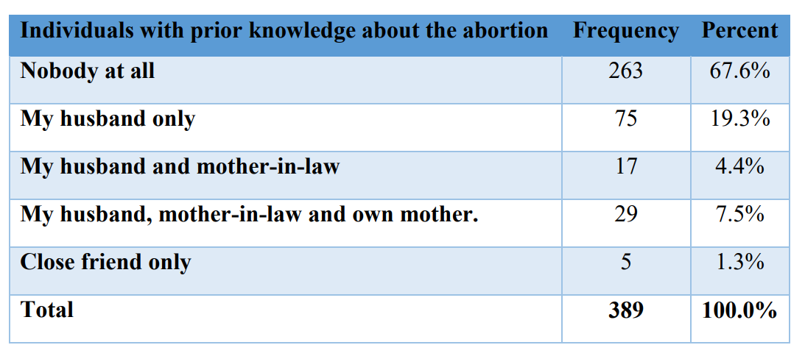
Case study: Abortion in the West Bank
Assessment of Safe and Unsafe Abortion among Palestinian Women in Hebron Governorate in Southern West Bank -Palestine.
Notes:
Reference:
Al Rifai Ayesha. Assessment of Safe and Unsafe Abortion among Palestinian Women in Hebron Governorate in Southern West Bank -Palestine. Jerusalem: Palestinian Family Planning and Protection Association (PFPPA); 2015 Jan.

Slide 25
Abortion in humanitarian settings
Adolescents in humanitarian settings are at increased risk for unintended pregnancy, due to their psychosocial development, existing gender and social power dynamics, socio-economic status, sexual violence and coercion, and traditional/cultural values that prevent access to SRH information and services.
Adolescents often lack awareness of and access to contraceptive methods to prevent pregnancy.
Adolescents are more likely than adults to seek unsafe abortions and/or to wait longer to seek abortion care, out of fear of stigma, policy constraints and structural barriers such as transportation costs, or delays in realizing they are pregnant.
Increasing recognition of the importance of providing SRH in humanitarian settings. Yet abortion services rarely provided.
Why are abortions an issue in humanitarian settings?
Sexual violence and rape often increase in humanitarian crisis
Access to contraception may be limited or disrupted and so women may experience unwanted pregnancies
Women who experience unwanted pregnancies and who do not have access to safe abortion services may resort to unsafe abortions
Source: McGinn and Casey, 2016
Notes:
Reference:
McGinn T, Casey SE. Why don’t humanitarian organizations provide safe abortion services? Conflict and Health. 2016 Mar 24;10(1):8. http://dx.doi.org/10.1186/s13031-016-0075-8

Slide 26
Regional opportunities
WHO guidance on self-care:
Can be a shift towards combatting stigma and privacy challenges by removing the need for a health care personnel (HCP) middle-person.
Digital technologies:
Provide some opportunity for support and counseling and even abortion care.

Slide 27
REGIONAL INITIATIVE 1
Marie Stopes International in Afghanistan (1,2,3)
Marie Stopes International (MSI, an NGO) in Afghanistan is one of the largest providers of family planning services and post abortion care in the country.
Aim: By 2030, no abortion will be unsafe and every individual who wants access to contraception will have it. To accomplish this:
Provide services where and when women and girls need them without discrimination
Remove un-necessary stigma, legal, and policy challenges, where possible
Ensure women and girls know their legal rights and entitlements
Ensure the provision of affordable care
Provide real choice in contraceptive methods and health service providers
Presence in the country:
36 centers offering a comprehensive range services, including contraception and post-abortion care
40 Marie Stopes Ladies and 10 mobile outreach teams that bring services to women and girls living in urban slums and some hard-to-reach rural areas
Impact :
156,000 unsafe abortions averted in 2019 (1)
286,000 unintended pregnancies were avoided in 2019 (1)
Notes:
Stigma feeds silence, and silence feeds myths. Myths that misinform, mislead and further stigmatize is a vicious and harmful circle that we need to break.
(Marie Stopes International: https://www.msichoices.org/what-we-do/no-more-unsafe-abortion/)
References:
Marie Stopes International Reproductive Choices. Afghanistan. MSI Reproductive Choices; c2020. Available from: https://www.msichoices.org/where-we-work/afghanistan/
Marie Stopes International Reproductive Choices. Safe abortion and post-abortion care. Marie Stopes International Reproductive Choices; c2020. Available from: https://www.msichoices.org/what-we-do/our-services/safe-abortion-and-post-abortion-care
Marie Stopes International. Afghanistan. Finland Abroad; 2017. Available from: https://finlandabroad.fi/web/afg/funding-decisions/-/asset_publisher/TAKwM9X4KvQQ/ahaKytInterventionType/id/1159554

Slide 28
REGIONAL INITIATIVE 1
Marie Stopes International in Afghanistan, cont. (1,2,3)
Specific initiatives:
The Integrated Reproductive and Maternal Health Project: Aims to improve the availability, accessibility, quality, and acceptability of SRH information and services for vulnerable and marginalized women, girls, men, and boys in six provinces of Afghanistan. The project is aligned with the national development goals of Afghanistan and contributes to the enhancement of the rights and status of women and girls and the reduction of poverty and inequality.
Smash Abortion Stigma Campaign: Aims to increase community acceptance for SRH services by engaging with key stakeholders e.g. religious leaders and their wives. In 2015, an estimated 30% of clients were referred through religious leaders or religious leaders' wives.
Response to COVID-19: Aims to engage with partners to ensure that contraception, safe abortion, and post-abortion care are defined by governments as ‘essential services’ and available in the basic package of services.
Notes:
References:
Marie Stopes International Reproductive Choices. Afghanistan. MSI Reproductive Choices; c2020. Available from: https://www.msichoices.org/where-we-work/afghanistan/
Marie Stopes International Reproductive Choices. Safe abortion and post-abortion care. Marie Stopes International Reproductive Choices; c2020. Available from: https://www.msichoices.org/what-we-do/our-services/safe-abortion-and-post-abortion-care
Marie Stopes International. Afghanistan. Finland Abroad; 2017. Available from: https://finlandabroad.fi/web/afg/funding-decisions/-/asset_publisher/TAKwM9X4KvQQ/ahaKytInterventionType/id/1159554

Slide 29
REGIONAL INITIATIVE 2
IPAS initiative in Pakistan (Sharma et al., 2019)
IPAS (an NGO) is the only international organization solely focused on expanding access to abortion and contraception.
Aim: To engage with the government of Pakistan to stimulate political norm change on abortion through the entry point of maternal mortality.
Approaches used from 2012-2018:
Advocacy campaign: Hosted key provincial stakeholders to discuss the impact of unsafe abortion on women and girls, and to identify a solution for mitigating this impact, primarily by advocating for the use of the latest WHO endorsed uterine evacuation technologies.
Establishment of coordinating committees: Supported the establishment of the Punjab Reproductive Health Technology Assessment Committee (PRHTAC) and the Sindh Reproductive Health Technologies Assessment Committee (SRHTAC).
Expansion of availability of services: Supported the PRHTAC to include misoprostol and manual vacuum aspiration in the Essential Package of Health Services and essential lists as the reproductive health technology of choice for providing safe uterine evacuation and post-abortion care. As a result, the Department of Health in Punjab procured 10 million misoprostol pills from the government’s budget by 2015.
Notes:
In this context, IPAS Pakistan hosted a policy advocacy meeting with policymakers and key stakeholders in Punjab, the most populace province in Pakistan, on 20th July 2012 to share an overview of the current status of morbidity and mortality related to unsafe abortions and to introduce Ipas and its global model for the prevention and management of unsafe abortion using WHO-endorsed technologies for safe UE. The meeting participants were concerned about the high rate of abortion-related morbidity and mortality but felt restricted by the prevailing stigma around abortion in Pakistan. They were also concerned about the misuse of misoprostol, especially by TBAs and untrained MLPs.
The advocacy efforts, led by IPAS Pakistan and local partners, to integrate WHO approved approaches (UE methods and training of additional cadres of providers) into the healthcare system. In particular, it details the work done to establish the Punjab Reproductive Health Technology Assessment Committee (PRHTAC)—a provincial body formed to review existing evidence on UE technologies, address concerns about stigma, examine a legal basis for clinical expansion to MLPs, consider the financial implications of new technologies, and, ultimately, to make recommendations/changes for the adoption of misoprostol and MVA into the local health-care system.
Reference:
Sharma AC, Dhillon J, Shabbir G, Lynam A. Notes from the field: political norm change for abortion in Pakistan. Sexual and Reproductive Health Matters. 2019 May 31;27(2):126-32. http://dx.doi.org/10.1080/26410397.2019.1586819

Slide 30
REGIONAL INITIATIVE 2
IPAS initiative in Pakistan, cont. (Sharma et al., 2019)
Approaches used from 2012-2018, cont.:
Task-shifting:
Trained midlevel providers in uterine evacuation and post-abortion care.
Included provision of misoprostol in the midwifery curriculum, given the non-surgical and less-skilled nature of the technology.
Quality of services:
Supported the implementation of a values clarification and attitude transformation (VCAT) training programme with service providers to increase support for the idea that no matter what an individual service provider’s beliefs are about abortion, no woman should suffer the loss of life because of lack of access to safe abortion services.
Contributed to the development of service delivery standards and guidelines for high-quality safe uterine evacuation and post-abortion care.
Scaling up:
To Sindh, the second most populous province with the formation of Sindh Reproductive Health Technologies Assessment Committee (SRHTAC) in 2016
Spotlighting of the national situation in the global human rights arena:
Highlighted the challenges that Pakistani women face in relation to safe abortion care in the UN Human Rights Committee.
The service delivery standards and guidelines for high-quality safe uterine evacuation and post-abortion care, which were endorsed by the MOH in March 2018. The MOH issued a related statement which mentioned the important needs of adolescents and disadvantaged women and girls in rural areas in December 2017.
Notes:
Reference:
Sharma AC, Dhillon J, Shabbir G, Lynam A. Notes from the field: political norm change for abortion in Pakistan. Sexual and Reproductive Health Matters. 2019 May 31;27(2):126-32. http://dx.doi.org/10.1080/26410397.2019.1586819

Slide 31
Lessons learned from the regional initiatives on the
provision of safe abortion services, where it is allowed
Expand data availability: Improve the availability of data on safe and unsafe abortion in the region (including abortion data in country’s DHS and other population-based surveys, HMIS, special studies), and the quality of data that are provided.
Improve access to services: Improve the the quality of SRH care and access to safe abortion care by addressing law/policy restrictions, strengthening providers’ competencies and attitudes, exploring opportunities for task-shifting, and disseminating information about the legal status of the abortion in the country and available services, including for adolescents.
Address determinants through prevention: Expand the availability of comprehensive sexuality education in schools to improve knowledge about SRH, prevent early marriages, increase the availability and quality of family planning services and post abortion care.
Sources: Moroccan Family Planning Association (MFPA); 2016 and Zaidi et al., 2014.
Notes:
References:
Moroccan Family Planning Association (MFPA). National report Morocco: Religious Fundamentalism and Access to Safe Abortion Services in Morocco. Rabat: MFPA; 2016. Available from: https://arrow.org.my/wp-content/uploads/2016/08/Interlinkages-Between-Religion-and-SRHR_National-Report__Morocco.pdf
Zaidi S, Begum F, Tank J, Chaudhury P, Yasmin H, Dissanayake M. Achievements of the FIGO Initiative for the Prevention of Unsafe Abortion and its Consequences in South-Southeast Asia. Int J Gynaecol Obstet. 2014 Jul;126 Suppl 1:S20-23. http://dx.doi.org/10.1016/j.ijgo.2014.03.015

Slide 32
Lessons learned from the regional initiatives on the
provision of safe abortion services, where it is allowed cont.
Create networks of supportive stakeholders for an enabling environment at the policy level: Identify potential areas of collaboration between civil society (including religious leaders), obstetrics/gynecology professionals, midwifery and nursing associations, and policy makers to look beyond pregnancy termination and focus more on maternal death and the negative health impacts associated with unsafe abortion and its burden on health systems.
Use pragmatic and health-oriented approaches:
Include post-abortion care, including post-abortion contraception, in the package of comprehensive reproductive health services.
Prevent and manage the complications of abortion in the context of health rights, to improve the status of women and girls.
In humanitarian settings: Ensure that contraception, safe abortion and post-abortion care are defined by governments as ‘essential services’ and are made available in the basic package of services.
Sources: Moroccan Family Planning Association (MFPA); 2016 and Zaidi et al., 2014.
Notes:
References:
Moroccan Family Planning Association (MFPA). National report Morocco: Religious Fundamentalism and Access to Safe Abortion Services in Morocco. Rabat: MFPA; 2016. Available from: https://arrow.org.my/wp-content/uploads/2016/08/Interlinkages-Between-Religion-and-SRHR_National-Report__Morocco.pdf
Zaidi S, Begum F, Tank J, Chaudhury P, Yasmin H, Dissanayake M. Achievements of the FIGO Initiative for the Prevention of Unsafe Abortion and its Consequences in South-Southeast Asia. Int J Gynaecol Obstet. 2014 Jul;126 Suppl 1:S20-23. http://dx.doi.org/10.1016/j.ijgo.2014.03.015

Slide 33
References
Global:
Guttmacher Institute. Adolescents’ need for and use of abortion services in developing countries. New York: Guttmacher Institute; 2016.
Guttmacher Institute. Fact sheet: Adding it up: Investing in adolescents’ sexual and reproductive health in low- and middle-income countries. New York: Guttmacher Institute; 2019.
Regional:
Al Rifai Ayesha. Assessment of Safe and Unsafe Abortion among Palestinian Women in Hebron Governorate in Southern West Bank -Palestine. Jerusalem: Palestinian Family Planning and Protection Association (PFPPA); 2015 Jan.
Center for Reproductive Rights. The World’s Abortion Laws. Center for Reproductive Rights; c 1992-2021. Available from: https://reproductiverights.org/worldabortionlaws
Ganatra B, Gerdts C, Rossier C, Johnson BR, Tunçalp Ö, Assifi A, Sedgh G, Singh S, Bankole A, Popinchalk A, Bearak J, Kang Z, Alkema L. Global, regional, and subregional classification of abortions by safety, 2010–14: estimates from a Bayesian hierarchical model. The Lancet. 2017 Nov 25;390(10110):2372-81. http://dx.doi.org/10.1016/S0140-6736(17)31794-4
Marie Stopes International Reproductive Choices. Afghanistan. MSI Reproductive Choices; c2020. Available from: https://www.msichoices.org/where-we-work/afghanistan/
Marie Stopes International Reproductive Choices. Safe abortion and post-abortion care. Marie Stopes International Reproductive Choices; c2020. Available from: https://www.msichoices.org/what-we-do/our-services/safe-abortion-and-post-abortion-care

Slide 34
References
Marie Stopes International. Afghanistan. Finland Abroad; 2017. Available from: https://finlandabroad.fi/web/afg/funding-decisions/-/asset_publisher/TAKwM9X4KvQQ/ahaKytInterventionType/id/1159554
McGinn T, Casey SE. Why don’t humanitarian organizations provide safe abortion services? Conflict and Health. 2016 Mar 24;10(1):8. http://dx.doi.org/10.1186/s13031-016-0075-8
Moroccan Family Planning Association (MFPA). National report Morocco: Religious Fundamentalism and Access to Safe Abortion Services in Morocco. Rabat: MFPA; 2016. Available from: https://arrow.org.my/wp-content/uploads/2016/08/Interlinkages-Between-Religion-and-SRHR_National-Report__Morocco.pdf
Ramirez FO, McEneaney EH. From women’s suffrage to reproduction rights? Cross-national considerations. Int J Comp Sociol. 1997 Jun;38(1-2):6-24.
Ranji A. Induced abortion in Iran: prevalence, reasons, and consequences. J Midwifery Womens Health. 2012 Oct;57(5):482-8. http://dx.doi.org/10.1111/j.1542-2011.2012.00159.x
Sharma AC, Dhillon J, Shabbir G, Lynam A. Notes from the field: political norm change for abortion in Pakistan. Sexual and Reproductive Health Matters. 2019 May 31;27(2):126-32. http://dx.doi.org/10.1080/26410397.2019.1586819
Soussane SY. Abortion in Morocco: will the king approve a progressive law? the Guardian. 2015 May 5 [cited 2016 Jun 22]. Available from: http://www.theguardian.com/global-development-professionals-network/2015/may/05/abortion-in-morocco-will-the-king-approve-a-progressive-law.

Slide 35
References
The regional reproductive, maternal, newborn, child, and adolescent health policy survey 2019. (unpublished data)
UNFPA. Addressing unintended pregnancy in the Arab region. UNFPA; 2018. Available from: https://arabstates.unfpa.org/sites/default/files/pub-pdf/addressing_unintended_pregnancy_in_the_as_report.pdf
United Nations, Department of Economic and Social Affairs, Population Division. Abortion policies and reproductive health around the world. United Nations; 2014. (Sales No. E.14.XIII.11). Available from: https://www.un.org/en/development/desa/population/publications/policy/abortionPoliciesAndReproductiveHealth.asp
WHO. Global Abortion Policies Database: Identified Policy and Legal Sources Related to Abortion: World Health Organization; c2017. Available from: https://abortion-policies.srhr.org/
WHO. Abortion. World Health Organization; c2022: Available from: https://www.who.int/health-topics/abortion#tab=tab_1
Zaidi S, Begum F, Tank J, Chaudhury P, Yasmin H, Dissanayake M. Achievements of the FIGO Initiative for the Prevention of Unsafe Abortion and its Consequences in South-Southeast Asia. Int J Gynaecol Obstet. 2014 Jul;126 Suppl 1:S20-23. http://dx.doi.org/10.1016/j.ijgo.2014.03.015

