Slide 1
Reaching adolescents through their parents
October 2016
Dr V Chandra-Mouli
chandramouliv@who.int
Training Course in Sexual and Reproductive Health Research
Geneva 2016

Slide 2
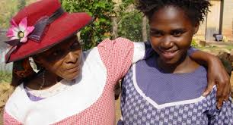
Parents are defined as those who provide primary or significant care for adolescents over a significant period without being paid. They include biological parents, foster parents, adoptive parents, grandparents and other relatives.
Notes:
Not all adolescents live with their biological parents.

Slide 3

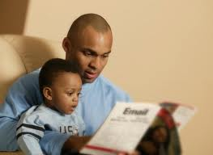
Key statement 1
We all recognize the crucial role that parents play in ensuring the survival, health & development of infants and children.

Slide 4

Key statement 2
Adolescents depend on their parents.
Parents continue have a crucial role to play in the health and development of their adolescent sons and daughters.
Notes:
Even though peers are important to adolescents, they depend on parents and other trusted adults for affection, identification and decision making.
Some adolescents trade the influence of their parents with that of their peers. This happens when the adolescent-parent relationship is not close.

Slide 5
Key statement 3
Parents have five complementary roles to play, each of which has specific influences on adolescent health outcomes:
1. connection – love
2. behaviour control – limit
3. respect for individuality – respect
4. modelling of appropriate behaviour – model
5. provision and protection – provide.
Notes:
A WHO review of carried out in 2007 identified five complementary roles for parents to play.
Source: WHO. Helping parents in developing countries improve adolescents' health. WHO. Geneva. 2007.

Slide 6

Key statement 4
A parent who plays these roles effectively is a powerful positive force in an adolescent's life.
Notes:
A parent who shows love, sets limits, respects evolving capacity, is a good role model and provides and protects the adolescent – is a powerful positive force in an adolescent's life. Adolescents without such parenting support are more vulnerable to health and social problems.
Source: WHO. Helping parents in developing countries improve adolescents' health. WHO. Geneva. 2007.

Slide 7

Key statement 5
Many parents find it hard to deal with their adolescents, and do not play these crucial roles in their lives effectively.
One area that many studies highlight is the inability of parents to communicate with their adolescents about sexuality and reproduction.
Notes:
One area that many studies highlight is the inability of parents to communicate with their adolescents about sexuality and reproduction.
Some parents truly believe that children and adolescents do not need sexuality education. Thy say: “They will learn what they need to, as they go along, just as we did.” Others know that sexuality education is important but are uncomfortable about broaching the subject. At best they do so in passing. “Don’t get pregnant like that girl down the street and bring shame to the family”, they say.
Source: Hindin MJ, Fatusi AO. Adolescent sexual and reproductive health in developing countries: an overview of trends and interventions. Int Perspect Sex Reprod Health. 2009 Jun;35(2):58-62. http://dx.doi.org/10.1363/ipsrh.35.058.09

Slide 8
Key statement 6
"Findings from a small number of intervention studies suggest that if parents are given support to develop the attributes of parental responsiveness, they can and will communicate with their children about sexuality".
Source: J Svanemyr, A Amin, O Robles, M E Greene. Creating an enabling environment for adolescent sexual and reproductive health: A framework and promising approaches. Journal of Adolescent Health. 56 2015. S7-S14.
Notes:
Interventions directed a parents can improve their parenting abilities. More importantly, this leads to tangible benefits

Slide 9
Key statement 7
There are many initiatives in developing countries – often led by non government organizations - to help parents support their adolescents. But most of them are small scale and time limited.

Slide 10
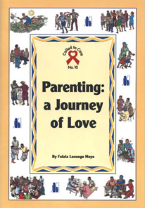
Key statement 8
There are some efforts under way to help large numbers of parents with the knowledge, attitudes and skills they need to help their adolescents.
Notes:
Parenting: A journey of love – was developed by the World Council of Churches with technical support from WHO.
It is being distributed and applied by the Strategies for Hope Trust.
Other such initiatives are urgently needed.

